Slide 1


Can IoT Devices be Powered up by Future Indoor Wireless Networks?
Tianxiang Li, Mohammad H. Mazaheri, Kalaivani Kamalakannan,
Haofan Lu, Omid Abari
Feb. 28, 2024
San Diego, CA, USA
HotMobile’24
Notes:
Good afternoon, everyone, I am Haofan Lu from UCLA. Today, I am going to talk about our investigation on powering up IoT devices by future indoor wireless networks. This is a joint work with my colleagues: Tianxiang, Mohammad, Kalaivani, and Omid.

Slide 2
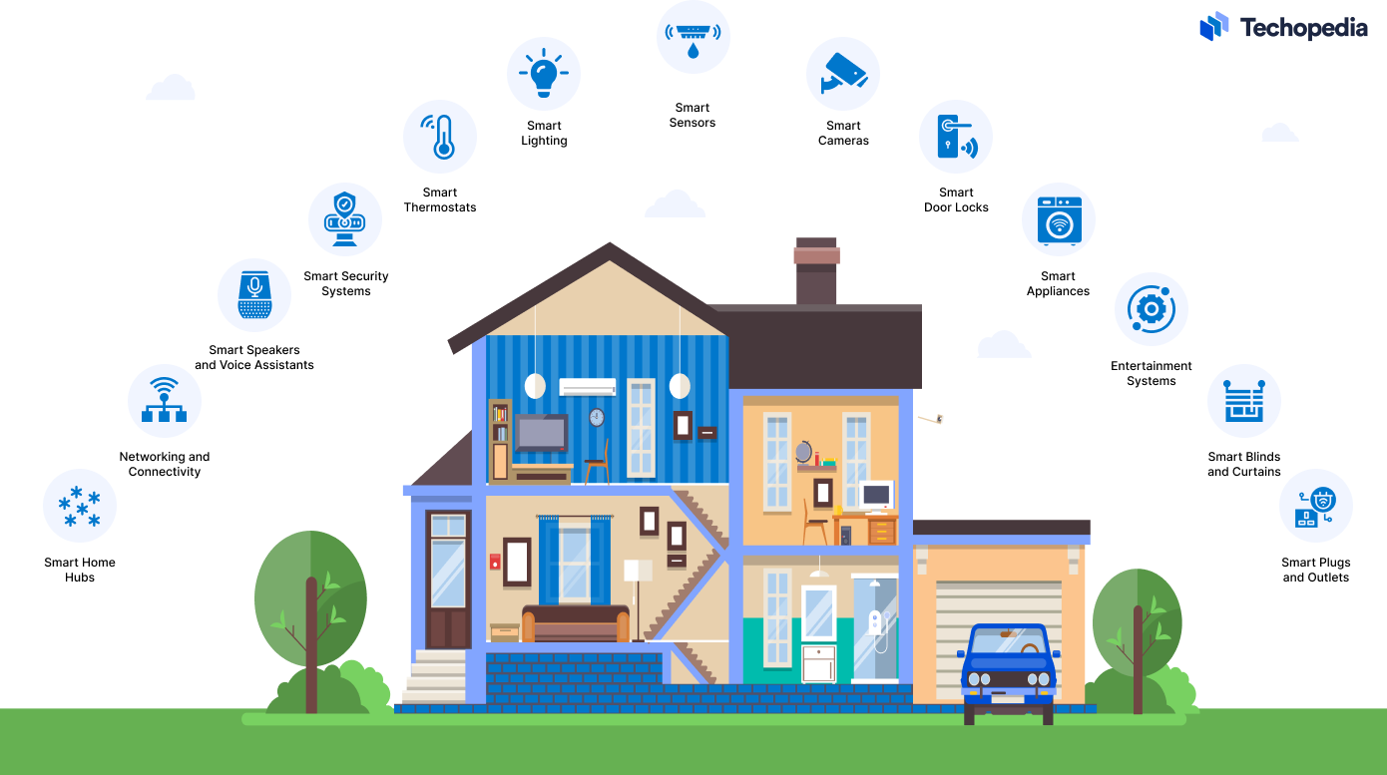
Growth of Internet of Things
Problem: frequent battery replacement
Notes:
In near future, each household is projected to have more than 20 IoT devices, such as smart speakers, temperature sensors and home security cameras. Most of them may rely on battery as the power source. Which means you will need to replace or recharge their battery every couple of weeks. This is a big headache for maintenance.

Slide 3
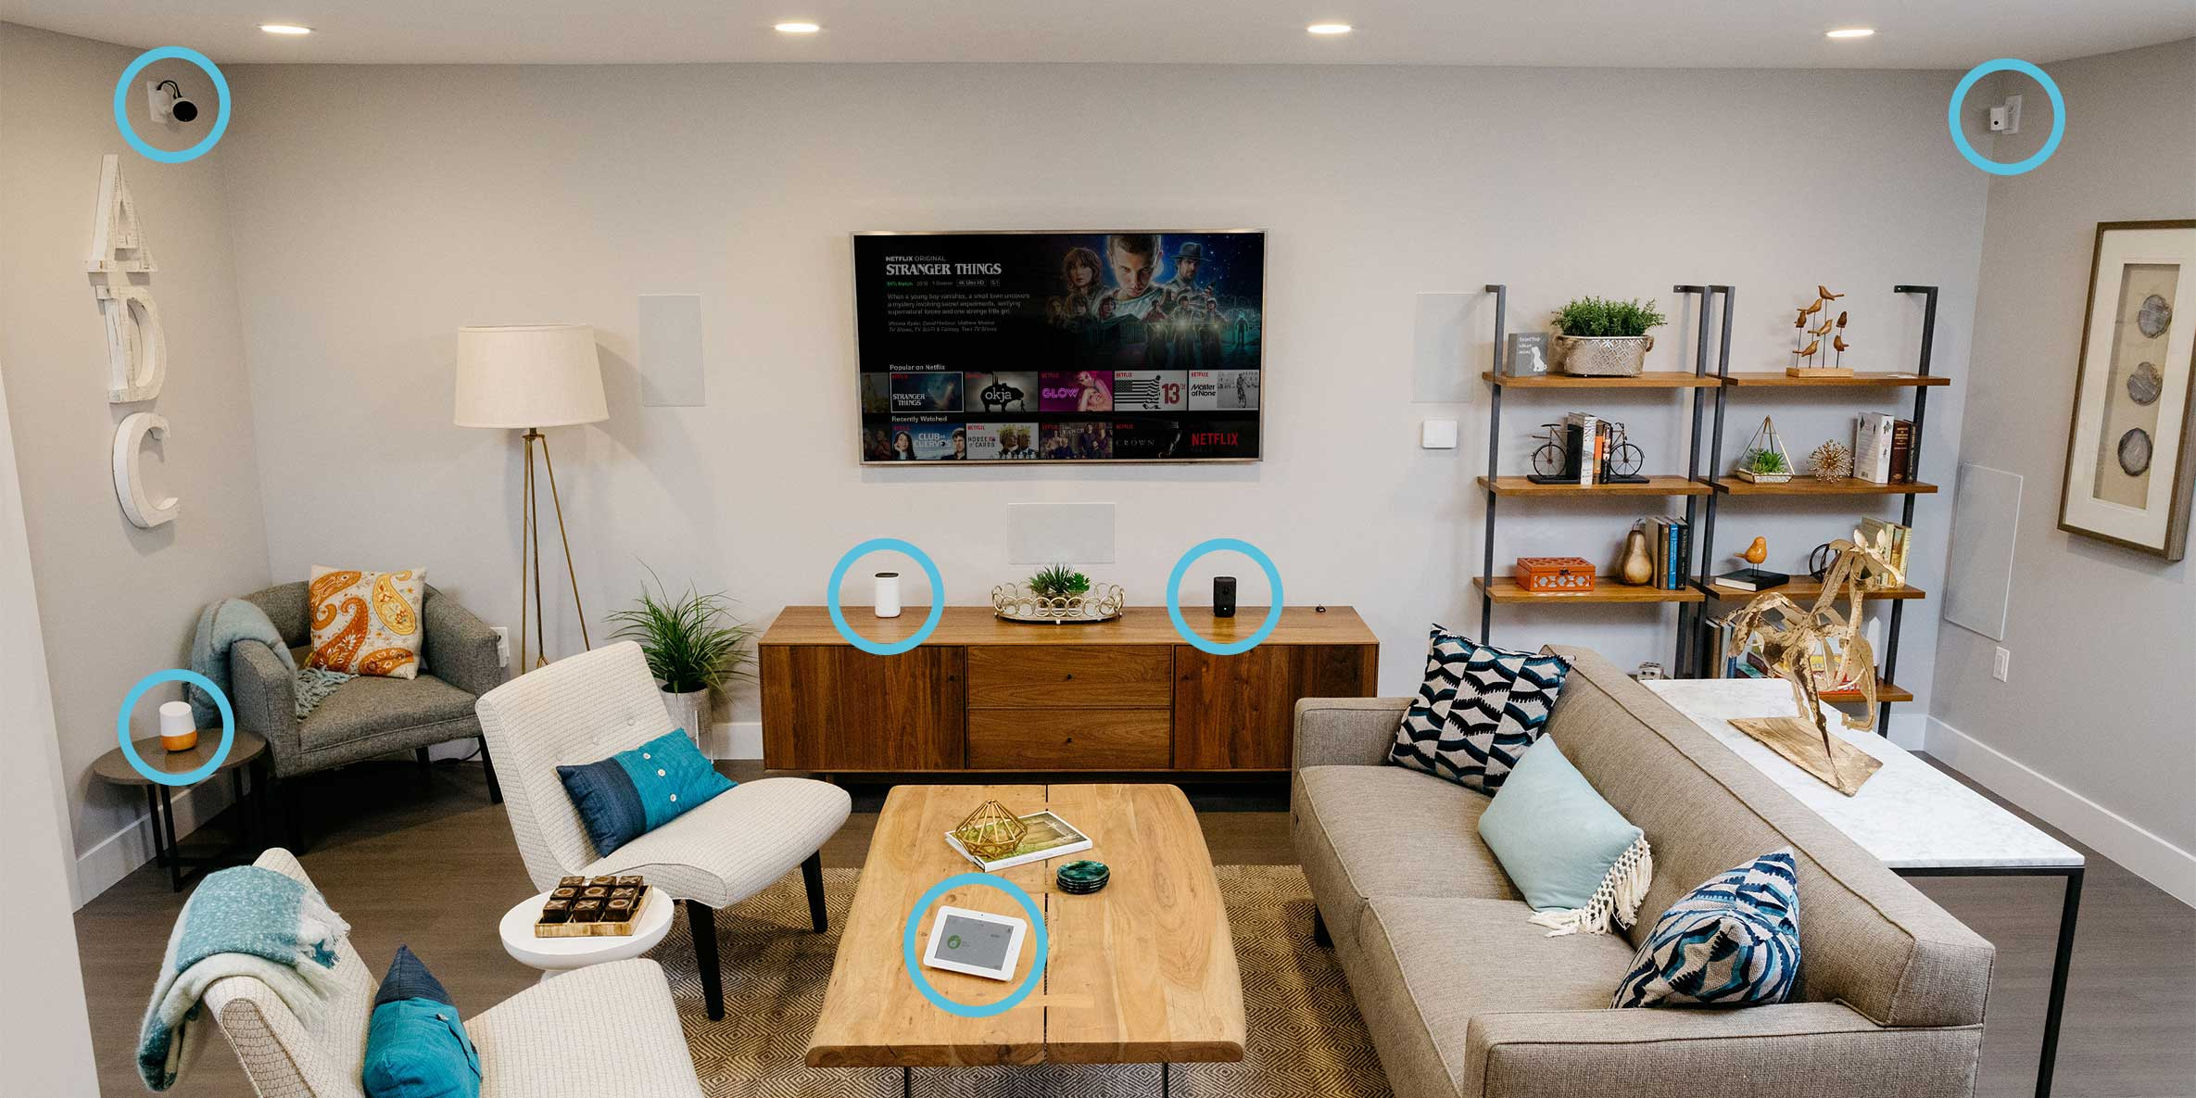
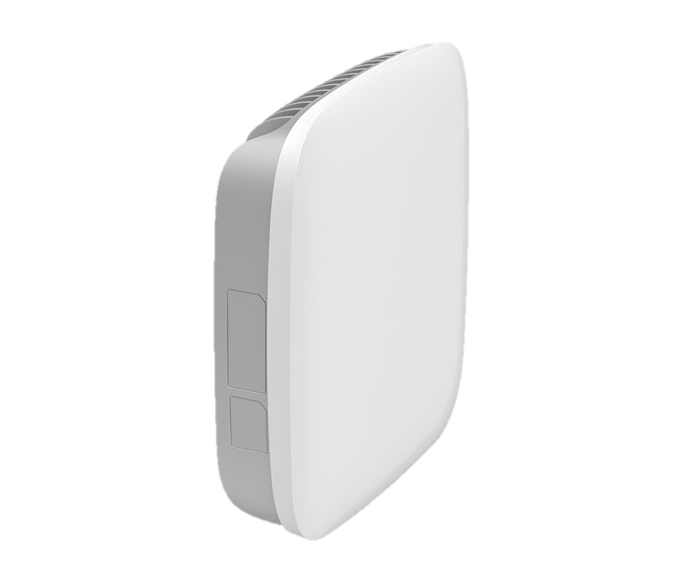
Our idea: Access Point are mostly idle during nights, use them to transfer power to IoT device batteries
What can we do?
Access
Points
Notes:
What can we do? The wireless access points in your home are underutilized while you are away for work or sleeping during the night. So, why not use them to transfer power to IoT devices in these time?

Slide 4
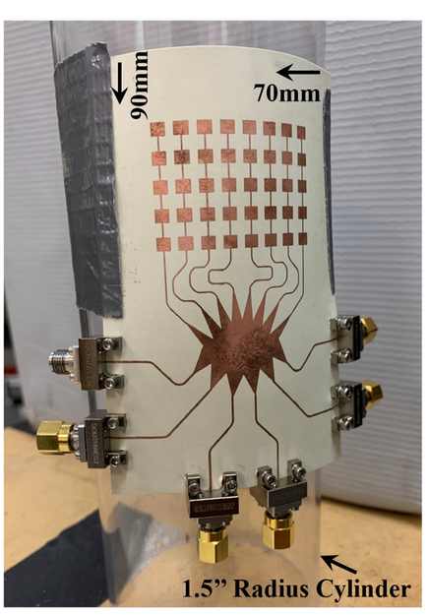
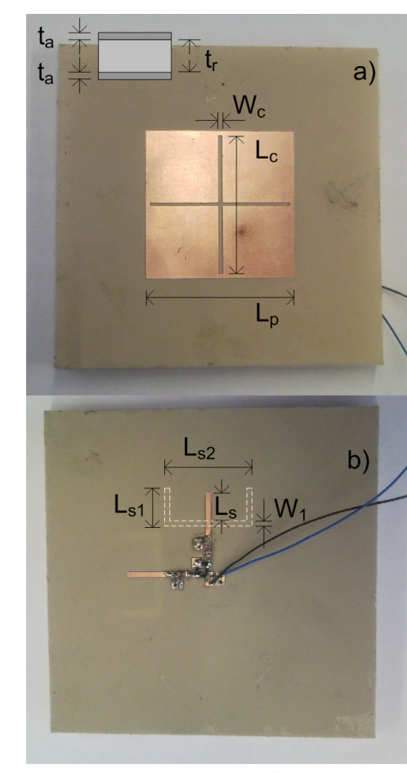
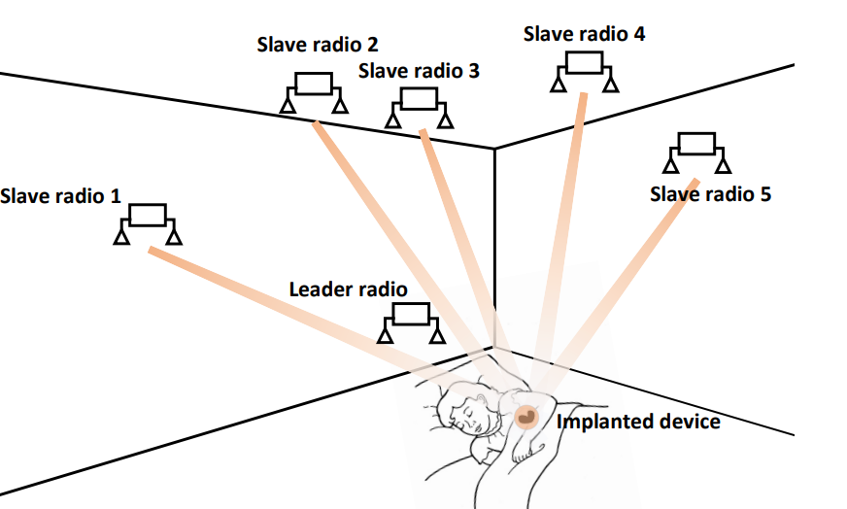
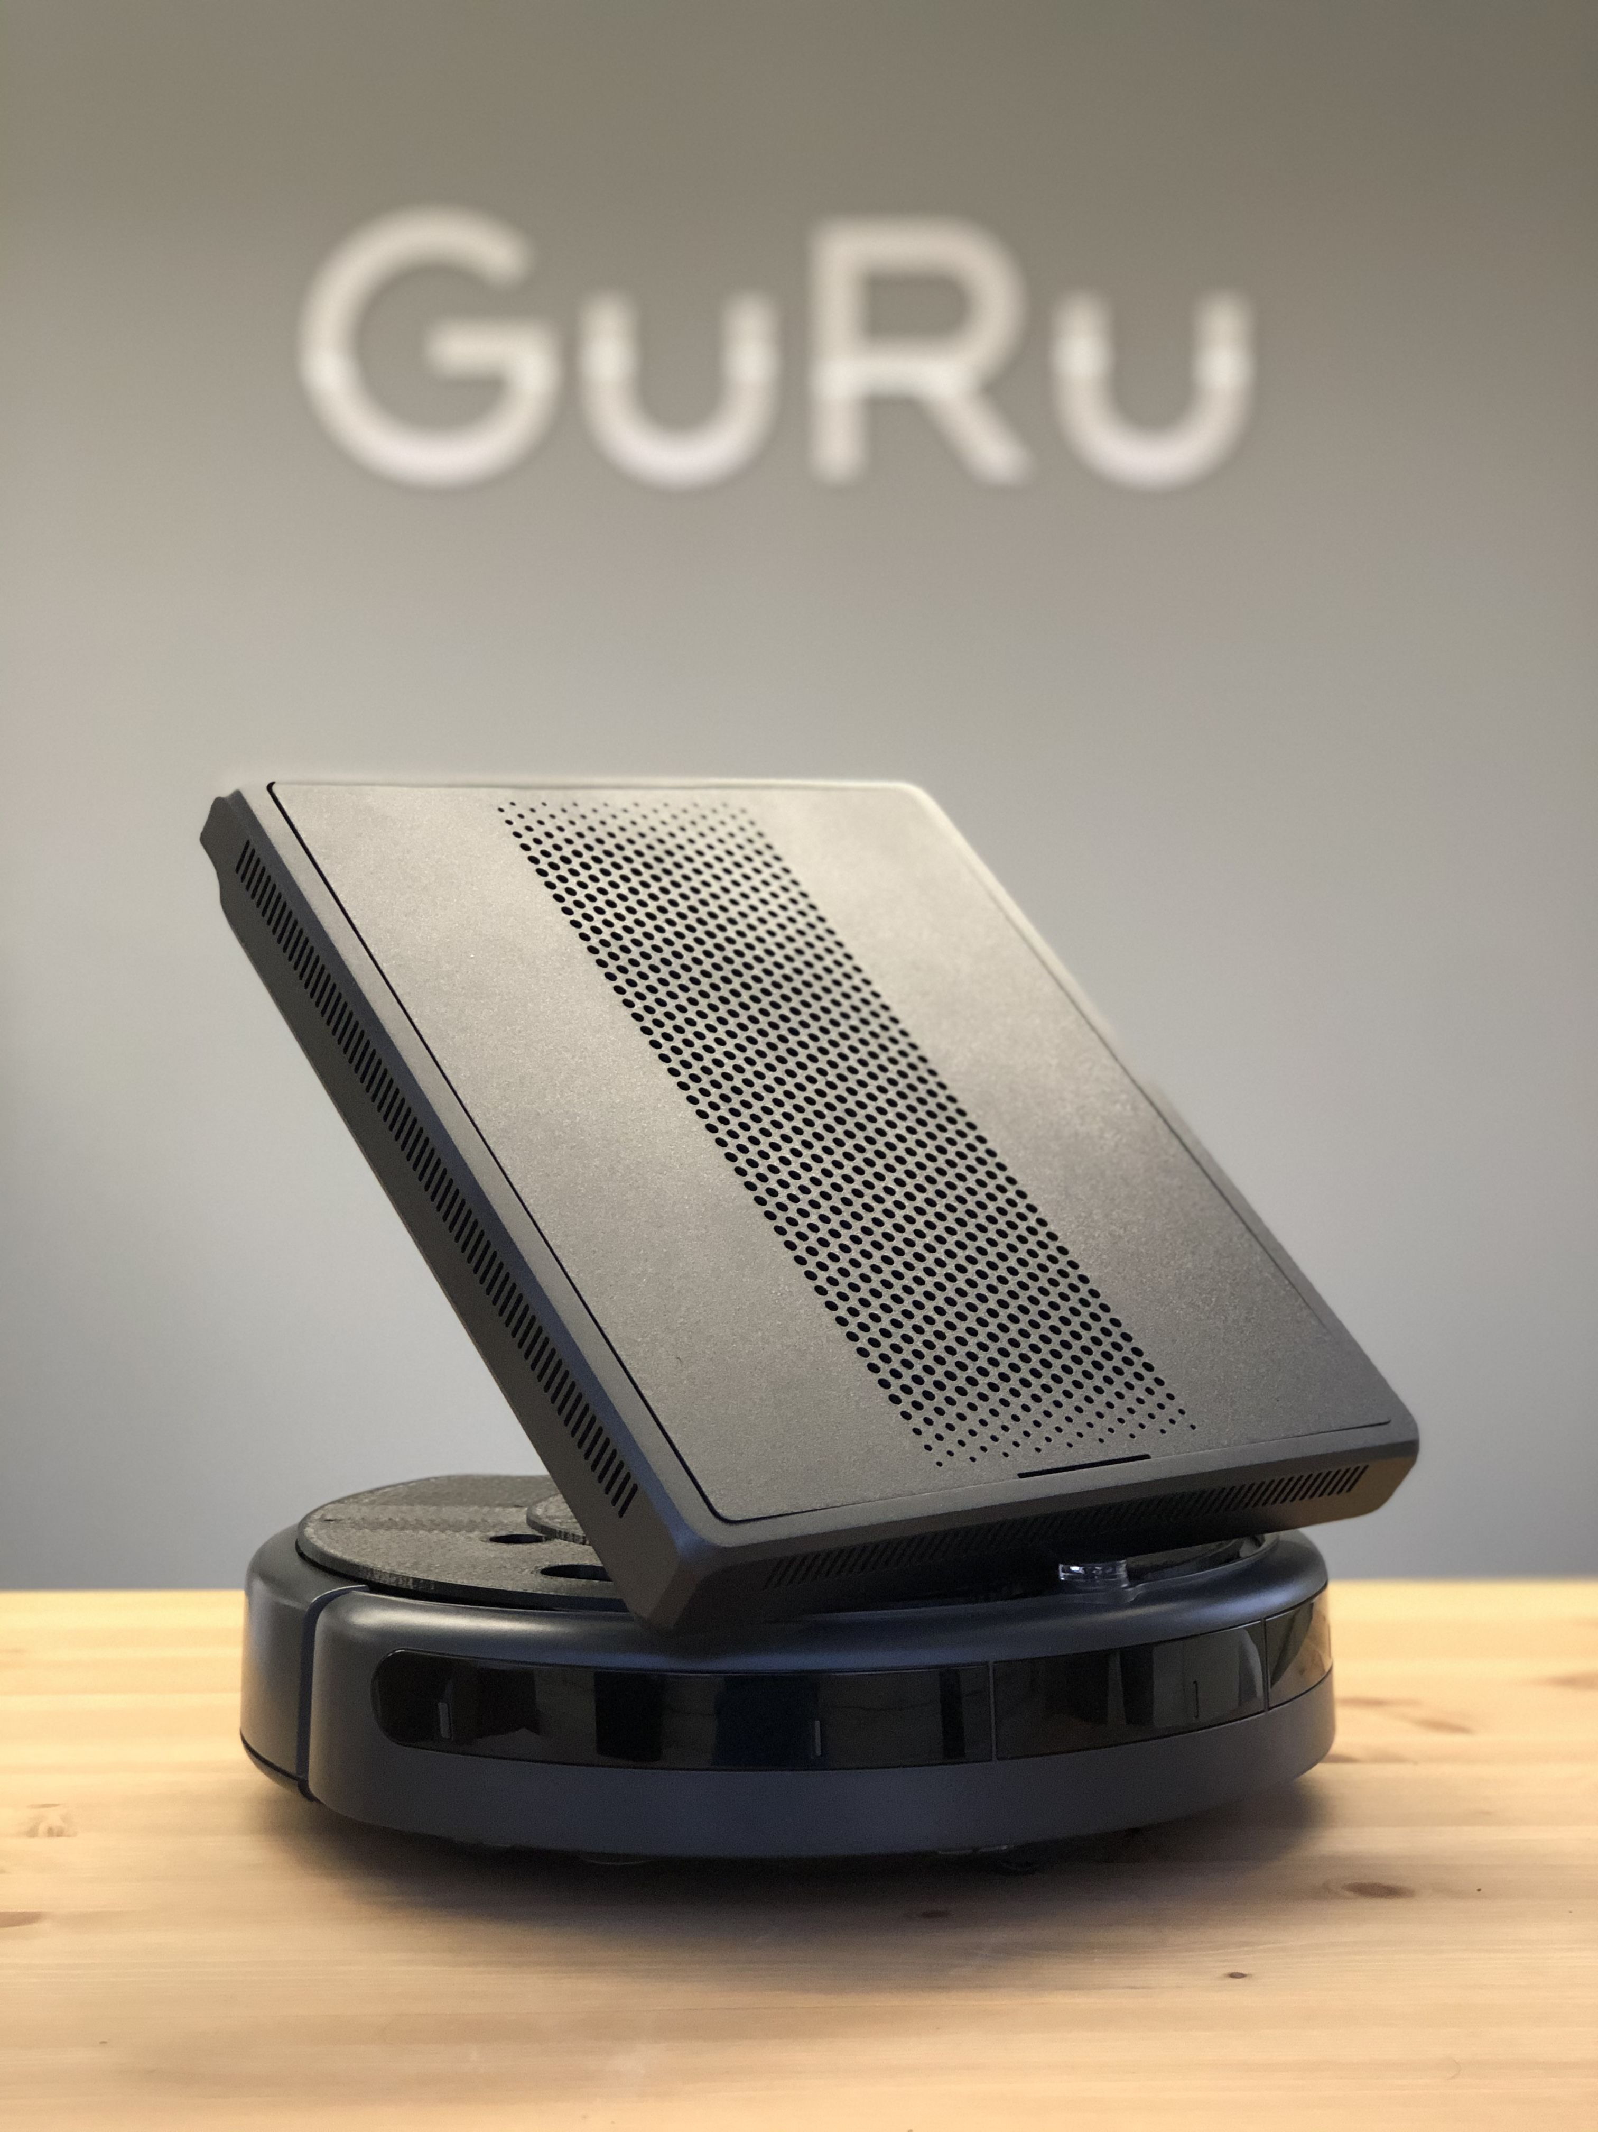
Which spectrum band serves better for wireless power transfer?
Existing wireless power transfer systems
915 MHz
(X. Fan et al., 2020)
2.4 GHz
(G. Andia Vera et al., 2010)
24 GHz
(GuRu, 2017)
28 GHz
(A. Eid et al., 2021)
Notes:
Of course, there have been some pioneer attempts on wireless power transfer, from 900MHz to 28 GHz. But there is not a comprehensive study on which band has better performance?
To realize this objective, the first question we need to answer is which spectrum serves better for wireless power transfer?

Slide 5






Which spectrum band serves better for wireless power transfer?
An End-to-End Evaluation
An End-to-End Evaluation
Tx Antenna
Gain
Rx Antenna
Gain
G_{tx}
EIRP
Regulations
G_{rx}
P_{tx}
Propagation Path Loss
P_{rx}
P_{DC}
Rectifier
Circuit
L(f, d)
Power Conversion Efficiency (PCE):
$$η$$
Lower Frequency Bands
(900 MHz, 2.4 GHz, and 5.8 GHz)
Higher Frequency Bands
($≥$24 GHz)
Path loss
Low
High
PCE
High
Low
Regulation EIRP
Low
High
Antenna Gain
Low
High
Notes:
To answer this question, we conducted an end-to-end evaluation. We consider a wireless power transfer system where there is a radio transmitter and receiver. The receiver antenna is connected to a rectifier circuit to convert the received RF power to DC power. The transmitter sends a signal of power Ptx, which is then amplified by the transmitter antenna gain GTx. The sum of Ptx and Gtx is known as Equivalent isotropic radiated power (EIRP) and is limited by FCC regulation. The signal then experiences free space path loss L, which is a function of propagation distance and signal frequency. When the signal reaches the rx antenna, it is amplified by the gain of receiver antenna Grx and results in Prx. The rectifier circuit has a power conversion efficiency, denoted by eta.
As we consider all these factors, the problem becomes non-trivial. Let me show you why. Here, I am showing a table, comparing lower frequency bands verses higher frequencies, in terms of all these factors. Although lower frequency bands have lower path loss and higher power conversion efficiency, their regulated EIRP and antenna gain are typically lower. On the other hand, higher frequency bands, such as mmWave, have higher path loss and lower power conversion efficiency, but they are allowed to have higher EIRP and antenna gain. As you can see from this qualitative analysis, it is hard to claim which spectrum bands is best for wireless power transfer. Therefore, we need to do a quantitative analysis.

Slide 6
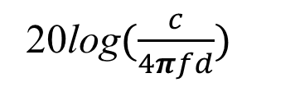
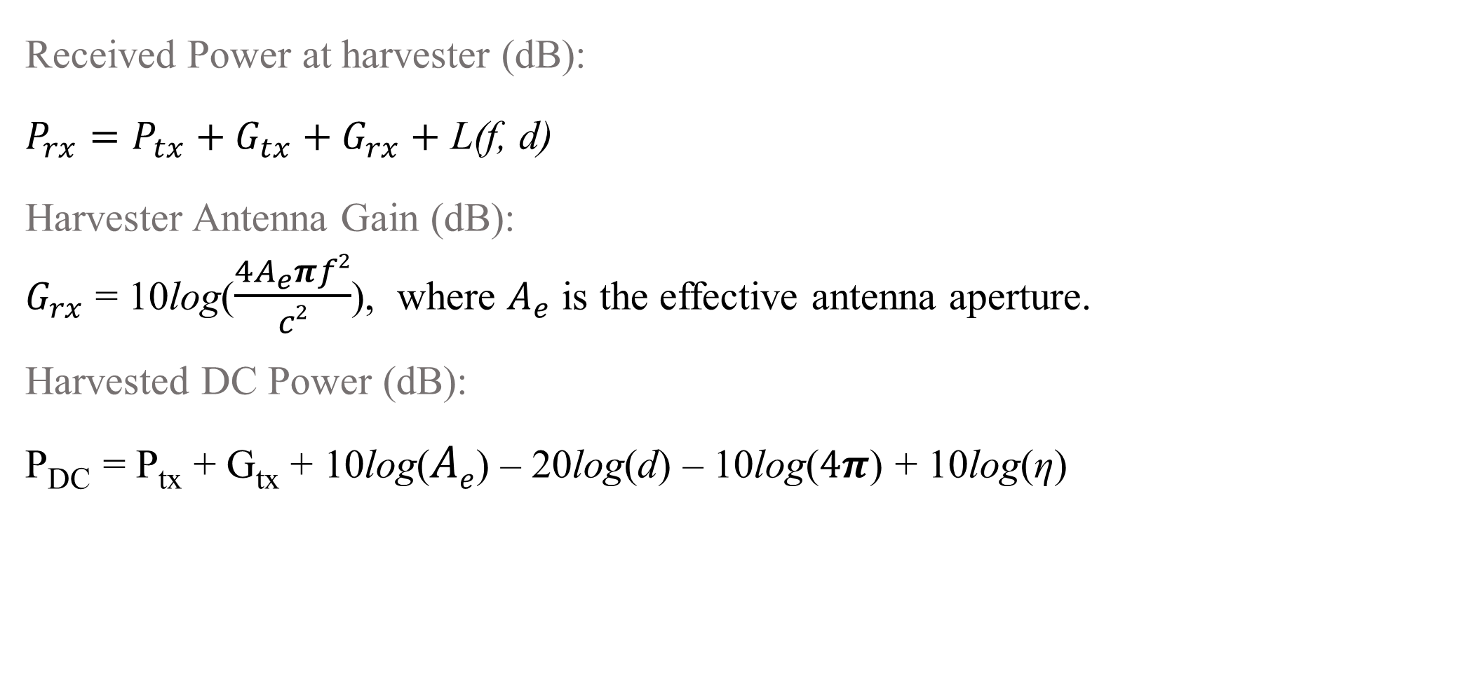




Link Budget Analysis
$$G_{tx}$$
$$G_{rx}$$
Received Power at harvester (dB):
$P_{rx}=P_{tx}+G_{tx}+G_{rx}+$ L(f, d)
Harvester Antenna Gain (dB):
$G_{rx}$ = 10log($\frac{4A_{e}πf2}{c2}$), where $A_{e}$ is the effective antenna aperture.
Harvested DC Power (dB):
P_{DC} = P_{tx} + G_{tx} + 10log($Ae$) – 20log(d) – 10log($4π$) + 10log(η)
$$P_{tx}$$
$$P_{rx}$$
P_{DC}
Rectifier
Circuit
20log$(\frac{c}{4πfd})$
L(f, d)
η
Notes:
We do a link budget calculation for the quantitative analysis. The received power at the harvester can be calculated as Ptx+Gtx+Grx+free space path loss, which is calculated using this formula. The harvester antenna gain Grx is calculated as …., where Ae is the effective antenna aperture. Finally, the harvested DC power can be written as this equation. Interestingly, the harvested power is not dependent on the operating frequency. This is due to the fact that for the same antenna aperture, the pathloss is balanced by the antenna gain.

Slide 7
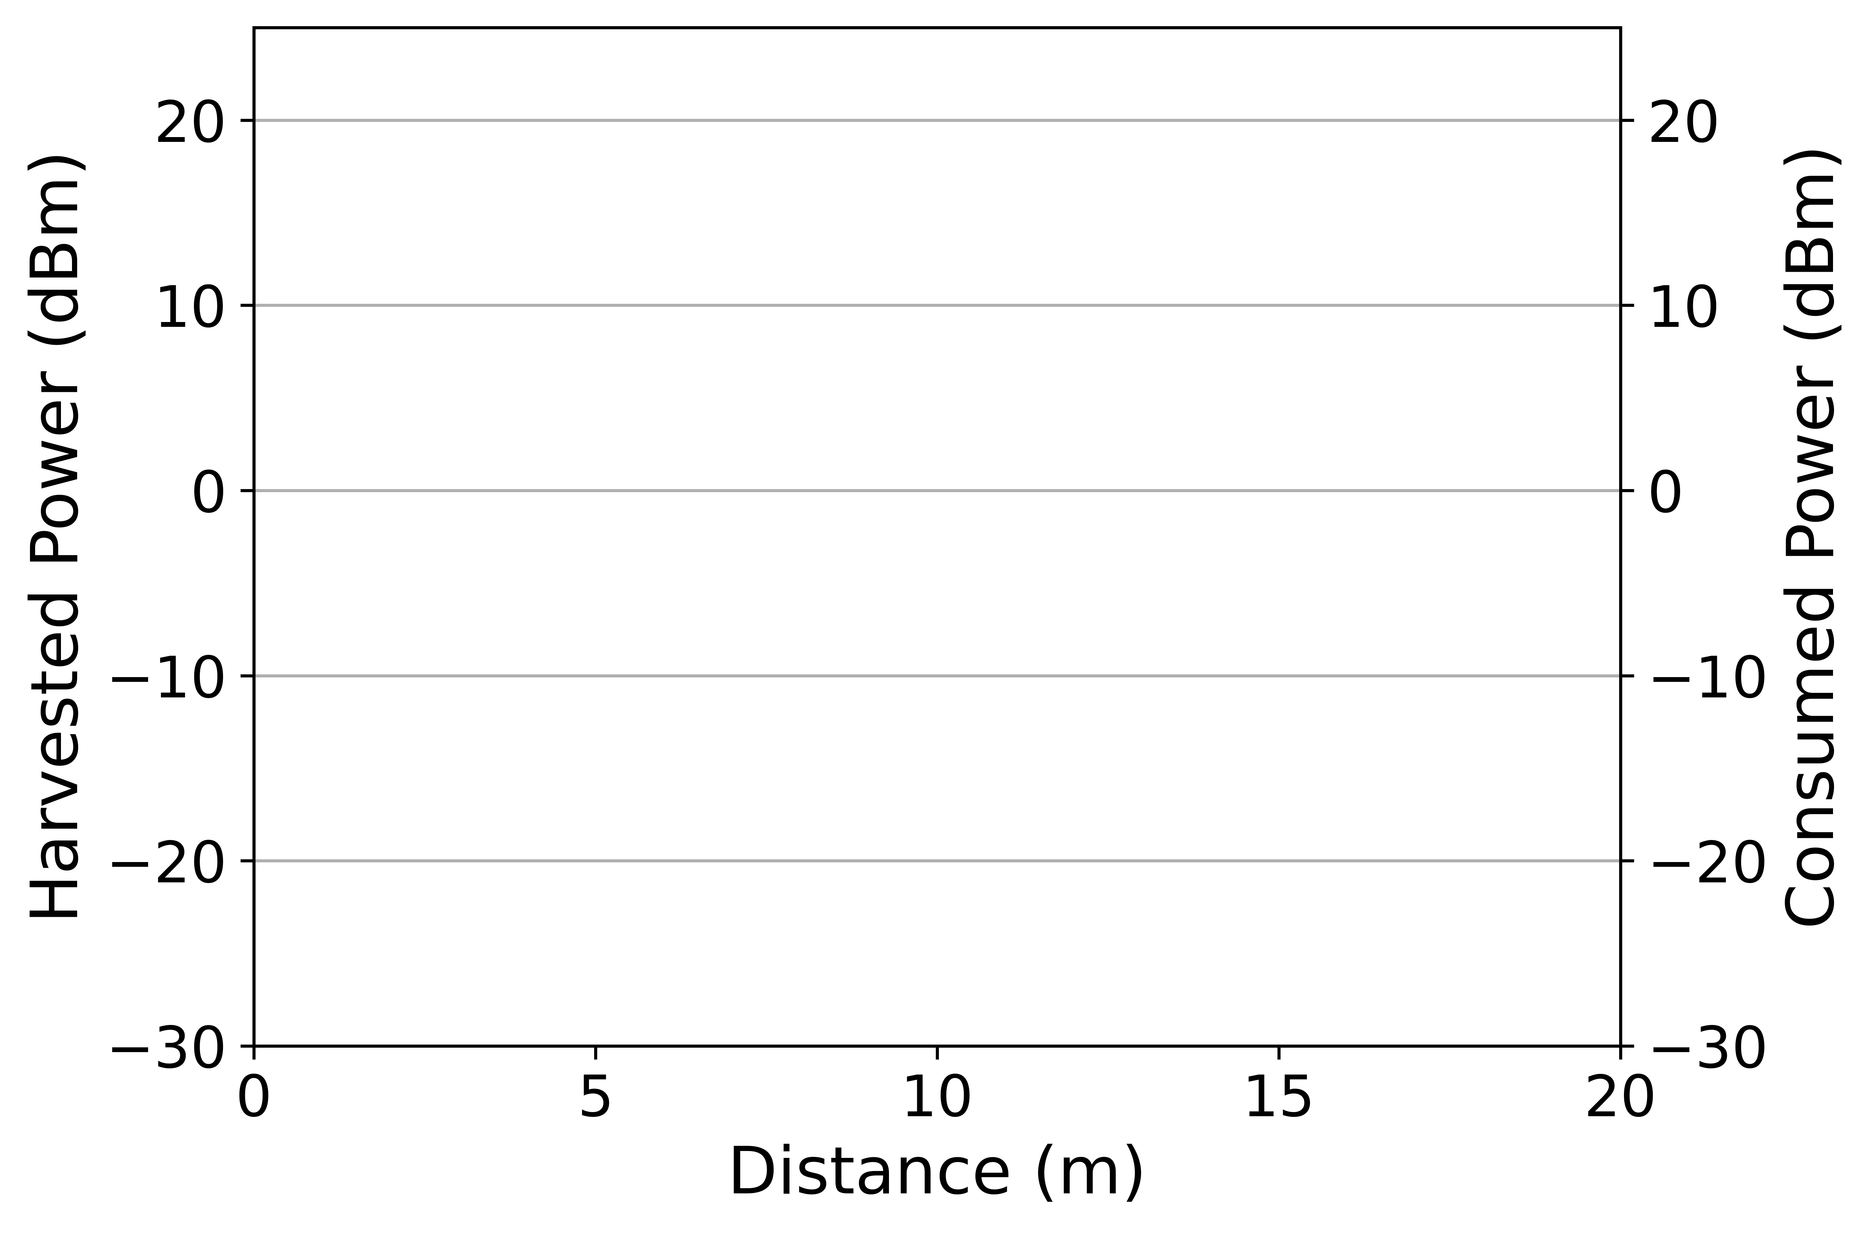
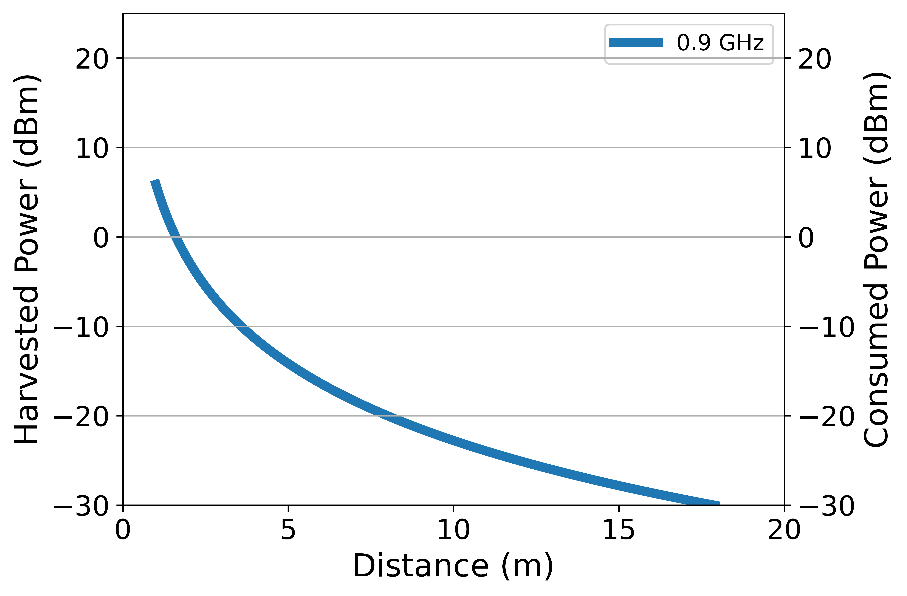
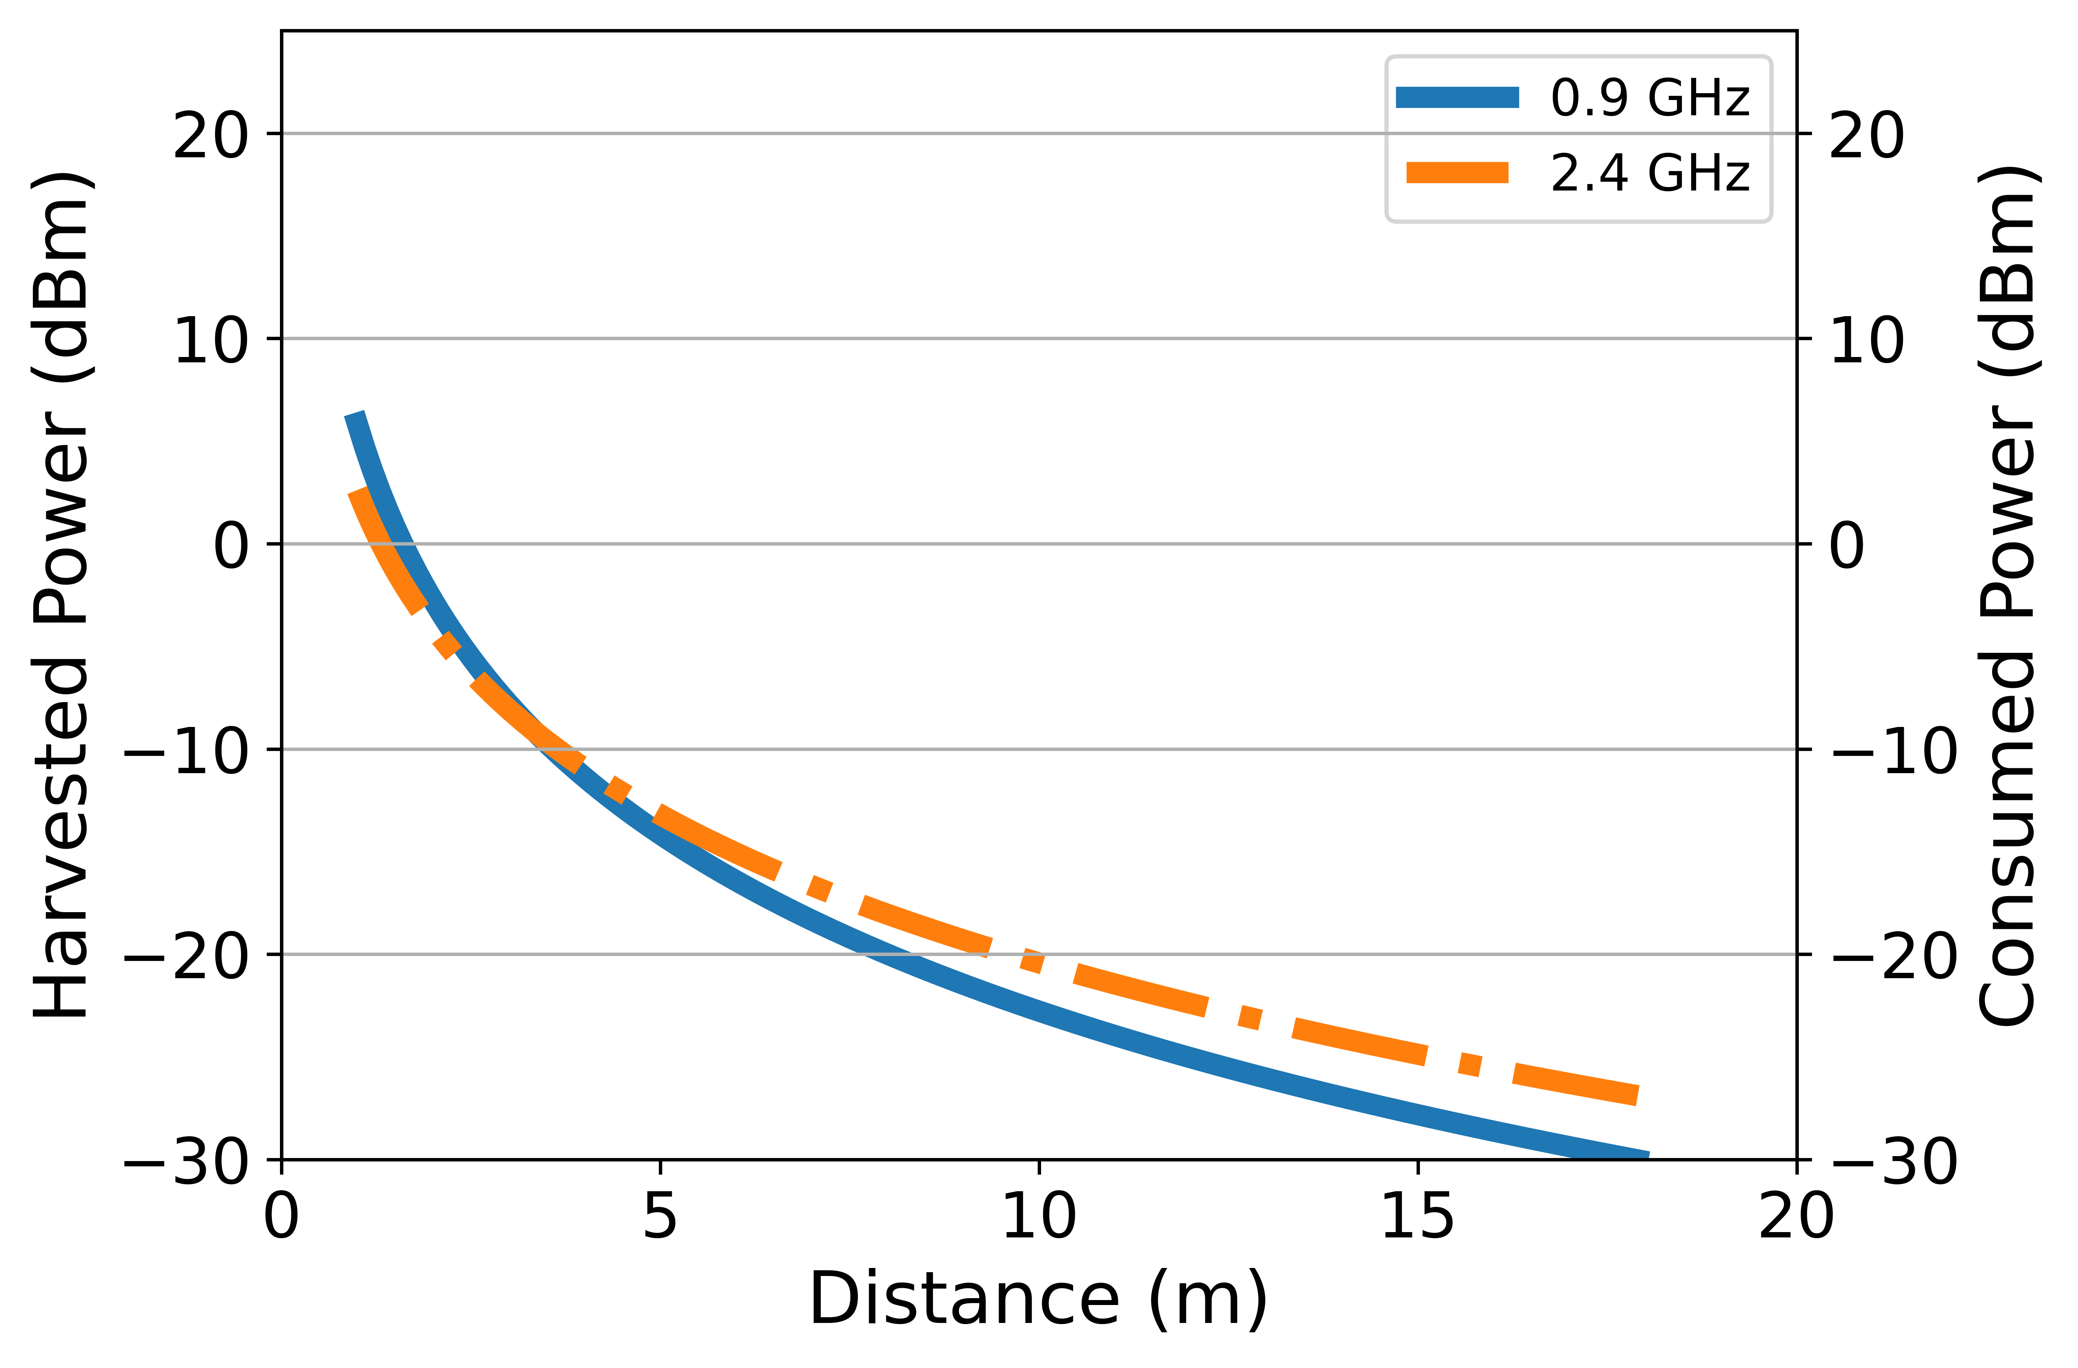
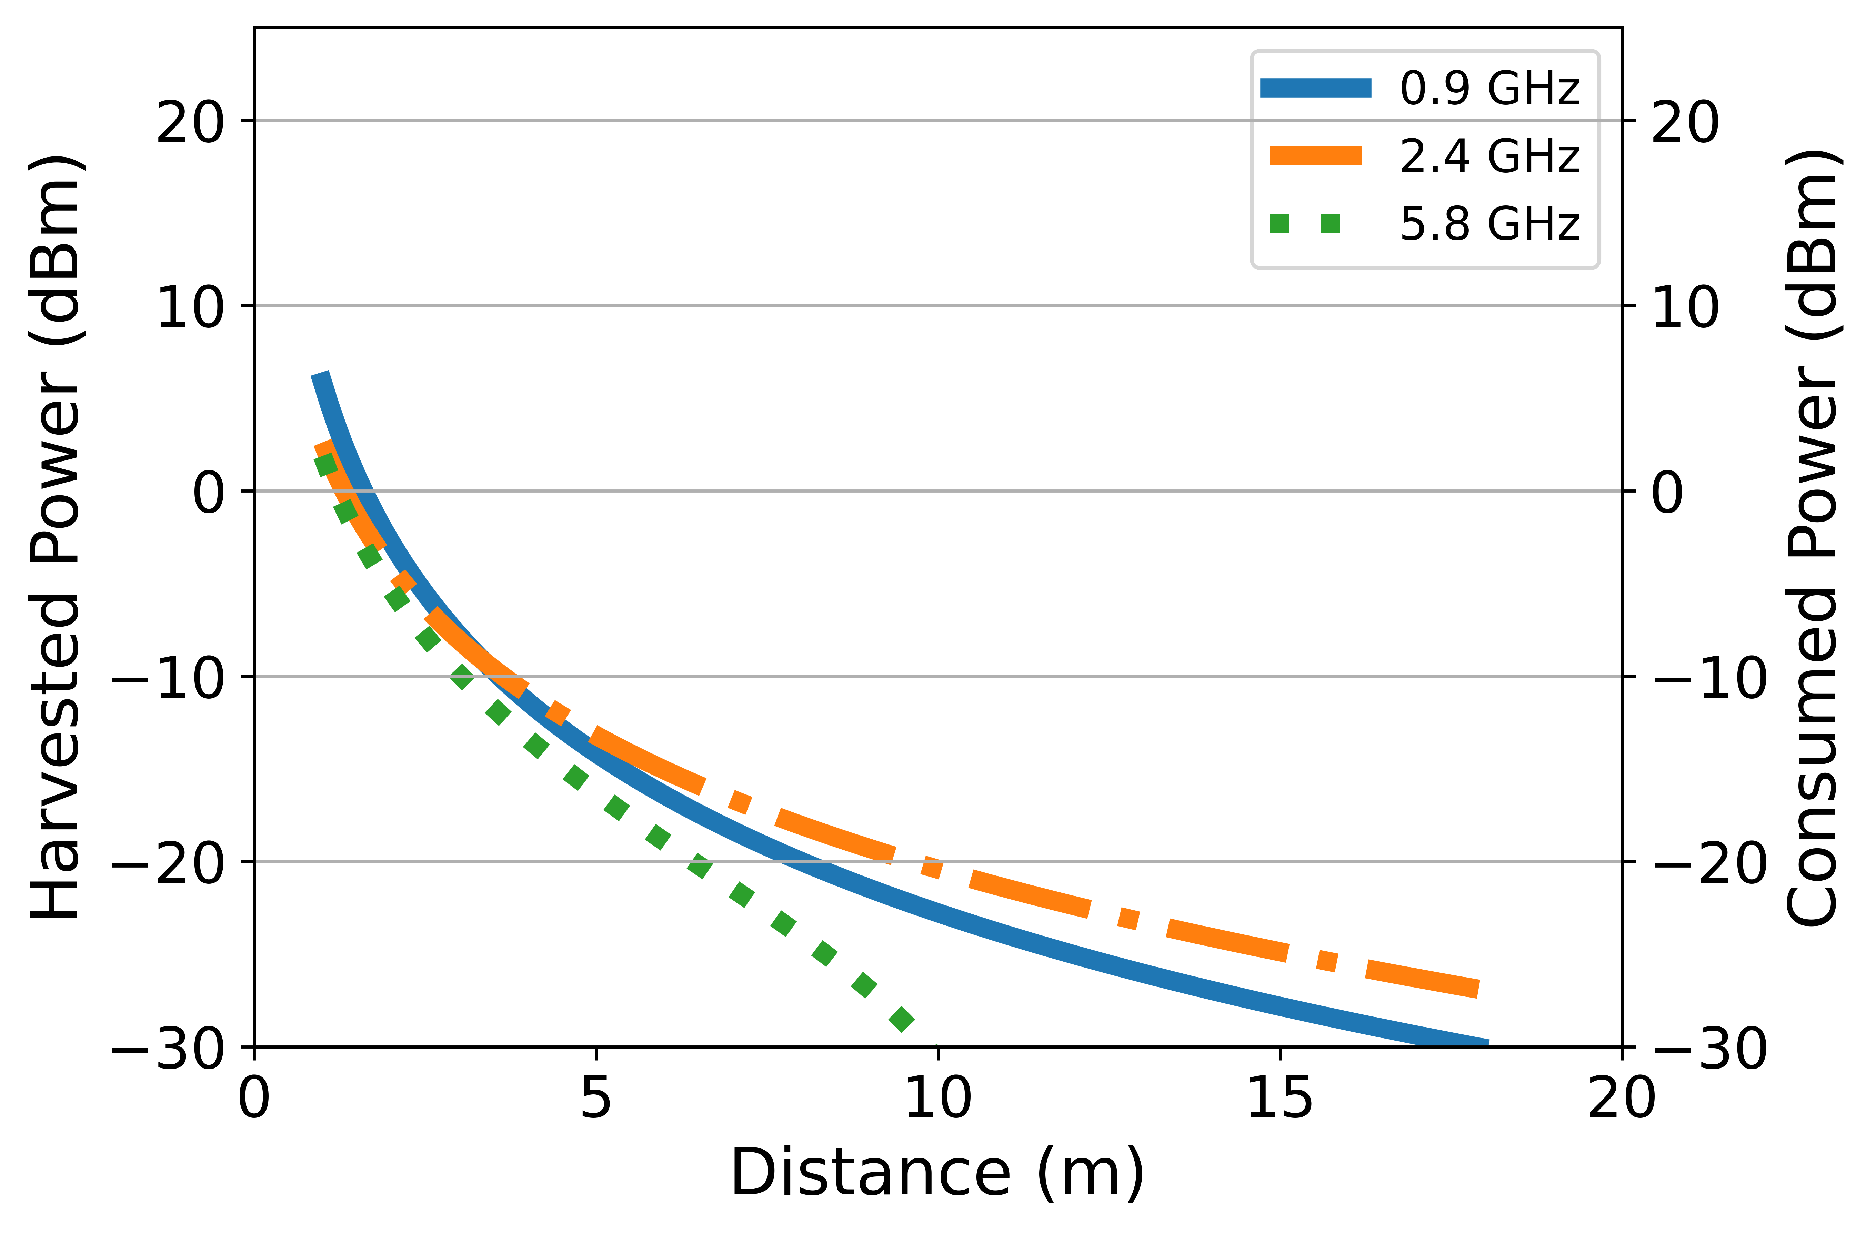
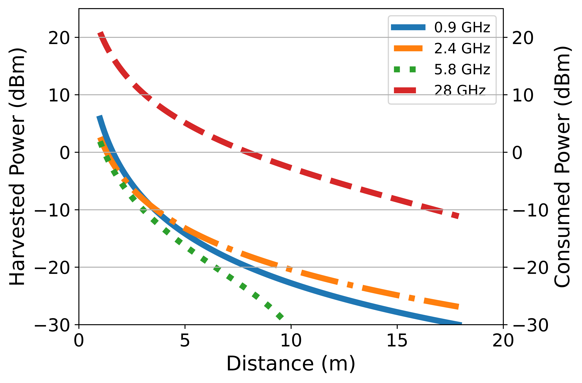
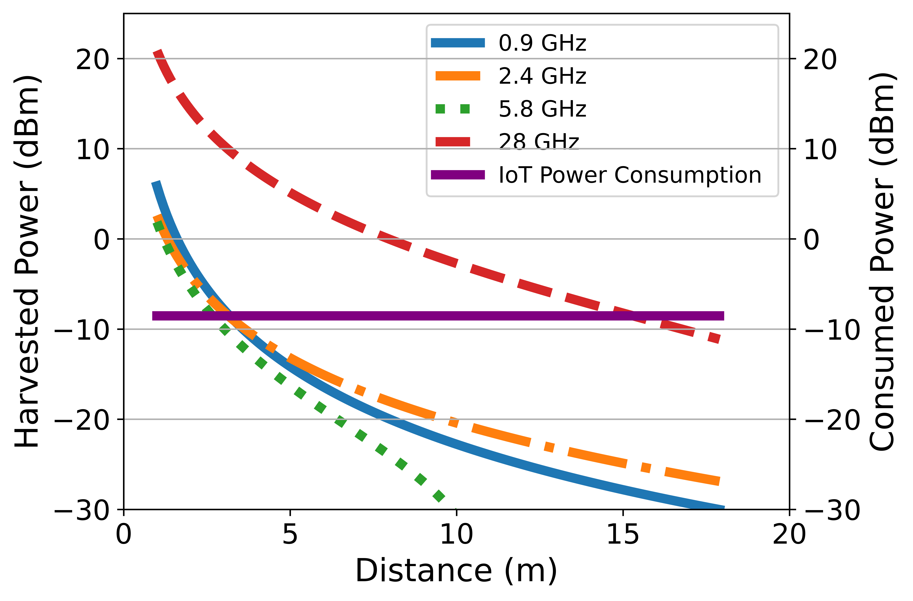
Harvested Power vs Distance Simulation
mmWave is a better candidate for wireless power transfer
Notes:
Here we show you the simulation results of harvested power vs distance between the transmitter and harvester. Here I am plotting the harvested power when the harvester is at difference distances from the transmitter. For 0.9 GHz, it’s this line.. 2.4 this line, 5.8 this line and 28 GHz, it’s this line. As you can see, harvested power at mmWave frequency is much higher than lower frequencies. This is because mmWave have much higher EIRP than lower frequencies. And finally, we plot the typical power consumption of IoT devices, using google nest temperature sensor as an example, which is this line. As you can see, based on this simulation, mmWave can power IoT devices up to 15meters, which is more or less 5 times higher than the lower frequencies. As a result, we suggest mmWave as a better candidate for wireless power transfer.
Make lines thicker

Slide 8
How can IoT devices harvest energy from indoor mmWave access points?
Notes:
Now that we know mmWave is the way to go, the next question is how can IoT devices harvest energy from indoor mmWave access points?

Slide 9
Challenges #1: How to perform beamforming?
Conventional solution: active beamforming using phased array
Our solution: passive beamforming using Frequency Scanning Antenna (FSA)
f₁
f₂
f₃
FSA
Rectifier
Circuit
IoT Device
f₄
f₅
Advantages:
Wide coverage angle
Zero power consumption
Notes:
The first challenge we need to solve is how to perform beamforming. Since millimeter wave have very high path loss, we need to design the antenna in a way such that energy are focused on a particular direction, which is called beamforming. The conventional approach is to use phased array, which is an active beamforming scheme that consumes additional energy when adjusting the phase shifters to steer the beam; therefore, is not suitable for low-power IoT devices. Instead, we propose to use a passive beamforming scheme named frequency scanning antenna (fsa). FSA creates beams for different frequencies towards different directions, as shown in this figure. We connect the FSA with a rectifier circuit and then the IoT device. The advantage of FSA is to guarantee a wide coverage angle while consuming zero additional power.
Bring voice up for FSA

Slide 10

Challenges #2: How to do beam alignment?
Goal: find the frequency and beam direction that align with the energy harvester
f₁
f₃
f₂
f₃
FSA
Rectifier
Circuit
IoT Device
f₄
AP
f₁
f₅
A naïve idea: use lower frequency radio to provide feedback to the AP
Problem: Additional power consumption to the IoT device
Notes:
Now we know how to create beams, the next problem is how to align the beam of the harvester with that of transmitter (or AP). Since FSA steers its beams by using different frequencies, this requires the AP to pick the right frequency and beam direction. For example, when the harvester is at this location, the AP should use frequency f3 in this direction. If the harvester moves to here, the AP should figure out to use frequency f1 in this direction. As you can imagine, realizing this function requires some sort of feedback mechanism to inform the AP about the current harvested power at the harvester. A naïve approach to achieve this is by using lower frequency radios, such as Bluetooth to establish a feedback link. The problem is, again, it causes additional power consumption.

Slide 11
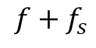

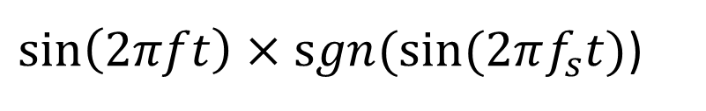
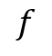
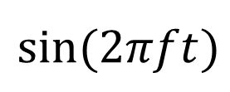
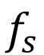
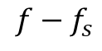
Challenges #2: How to do beam alignment?
Our idea: use backscatter to provide feedback
f₁
f₂
$$sin⁡(2πft)$$
f₃
FSA
Rectifier Circuit
f₄
$\sin\left(2πft\right)×sgn⁡(sin⁡(2πf_{s}t)$)
f₅
AP
$$f_{s}$$
Leakage
from Tx
Square wave of
frequency $f_{s}$
Backscatter Circuit
1st order harmonics
FFT
Key Observation:
The strength of the 1st order harmonics indicates the reflected signal strengths
→ Degree of alignment
Frequency
$$f−f_{s}$$
$$f$$
$$f+f_{s}$$
Notes:
Our idea is to use backscatter technique to provide feedback to the AP. Specifically, instead of directly connecting the FSA to the rectifier circuit, we connect it to a SPDT switch, which switches between ground and rectifier circuit. We let the AP transmit a continuous sine wave. In the meanwhile, we flip the switch at a frequency fs to create a frequency-shift modulation to the backscattered signal. In other words, the reflected signal is the sine wave multiplied by a square wave of frequency fs. if we plot the fft spectrum of the received signal, it has the following spikes: A strong spike at f, which is the leakage from transmitter, then the 1st order harmonics spikes at f-fs and f+fs. While there are other orders of harmonics, we omit them for simplicity . Our observation is that the strength of the 1st order harmonics represents the strengths of the reflected signal and indicates the degree of alignment. We leverage this observation to provide the feedback to AP with minimum power consumption.

Slide 12
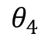
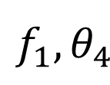
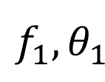
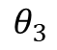
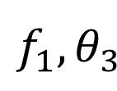
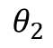
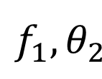
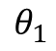
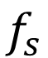
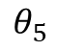
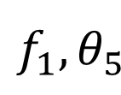
Beam Alignment Protocol
f₁
$$f_{1},θ_{1}$$
$$f_{1},θ_{2}$$
f₁
$$f_{1},θ_{3}$$
f₂
Signal Strength of 1st Harmonic
f₃
$$f_{1},θ_{4}$$
FSA
Rectifier Circuit
AP
f₄
$$f_{1},θ_{5}$$
f₅
$$f_{s}$$
Backscatter Circuit
Beam
direction
$$θ_{1}$$
$$θ_{2}$$
$$θ_{3}$$
$$θ_{4}$$
$$θ_{5}$$
Notes:
With this observation, we propose the following beam alignment protocol. For a particular signal frequency, AP scan its beam towards a discrete set of directions, and measure the signal strength of the 1st harmonics, as we plot it here. We do this for all the frequencies, which results in a table as show in the left. We pick the combination of frequency and direction that results in the strongest reflected signal as the best alignment with the harvester. You may question that this exhaustive scanning of frequency and direction have a O(n^2) complexity. In fact, we can transmit all frequencies at the same time, and just iterate the beam directions, which will lead to a O(N) complexity.

Slide 13
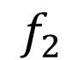
Beam Alignment Protocol
f₁
f₂
$$f_{2}$$
f₁
f₂
Signal Strength of 1st Harmonic
f₃
FSA
Rectifier Circuit
AP
f₄
f₅
$$f_{s}$$
Backscatter Circuit
Beam
direction
$$θ_{1}$$
$$θ_{2}$$
$$θ_{3}$$
$$θ_{4}$$
$$θ_{5}$$
Notes:
To this end, let me show you how we do beam alignment. For a particular signal frequency, AP scan its beam towards a discrete set of directions, and measure the signal strength of the 1st harmonics, as we plot it here. We do this for all the frequencies, which results in a table as show in the left. We pick the combination of frequency and direction that results in the strongest reflected signal as the best alignment with the harvester. You may question that this exhaustive scanning of frequency and direction have a O(n^2) complexity. In fact, we can transmit all frequencies at the same time, and just iterate the beam directions, which will lead to a O(N) complexity.

Slide 14
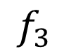
Beam Alignment Protocol
f₁
f₂
$$f_{3}$$
f₃
f₁
f₂
Signal Strength of 1st Harmonic
f₃
FSA
Rectifier Circuit
AP
f₄
f₅
$$f_{s}$$
Backscatter Circuit
Beam
direction
$$θ_{1}$$
$$θ_{2}$$
$$θ_{3}$$
$$θ_{4}$$
$$θ_{5}$$
Notes:
To this end, let me show you how we do beam alignment. For a particular signal frequency, AP scan its beam towards a discrete set of directions, and measure the signal strength of the 1st harmonics, as we plot it here. We do this for all the frequencies, which results in a table as show in the left. We pick the combination of frequency and direction that results in the strongest reflected signal as the best alignment with the harvester. You may question that this exhaustive scanning of frequency and direction have a O(n^2) complexity. In fact, we can transmit all frequencies at the same time, and just iterate the beam directions, which will lead to a O(N) complexity.

Slide 15
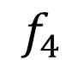
Beam Alignment Protocol
f₁
f₂
$$f_{4}$$
f₃
f₁
f₄
f₂
Signal Strength of 1st Harmonic
f₃
FSA
Rectifier Circuit
AP
f₄
f₅
$$f_{s}$$
Backscatter Circuit
Beam
direction
$$θ_{1}$$
$$θ_{2}$$
$$θ_{3}$$
$$θ_{4}$$
$$θ_{5}$$
Notes:
To this end, let me show you how we do beam alignment. For a particular signal frequency, AP scan its beam towards a discrete set of directions, and measure the signal strength of the 1st harmonics, as we plot it here. We do this for all the frequencies, which results in a table as show in the left. We pick the combination of frequency and direction that results in the strongest reflected signal as the best alignment with the harvester. You may question that this exhaustive scanning of frequency and direction have a O(n^2) complexity. In fact, we can transmit all frequencies at the same time, and just iterate the beam directions, which will lead to a O(N) complexity.

Slide 16
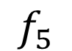
Beam Alignment Protocol
f₁
f₂
$$f_{5}$$
f₃
f₁
f₄
f₂
f₅
Signal Strength of 1st Harmonic
f₃
FSA
Rectifier Circuit
AP
f₄
f₅
$$f_{s}$$
Backscatter Circuit
Beam
direction
$$θ_{1}$$
$$θ_{2}$$
$$θ_{3}$$
$$θ_{4}$$
$$θ_{5}$$
Notes:
To this end, let me show you how we do beam alignment. For a particular signal frequency, AP scan its beam towards a discrete set of directions, and measure the signal strength of the 1st harmonics, as we plot it here. We do this for all the frequencies, which results in a table as show in the left. We pick the combination of frequency and direction that results in the strongest reflected signal as the best alignment with the harvester. You may question that this exhaustive scanning of frequency and direction have a O(n^2) complexity. In fact, we can transmit all frequencies at the same time, and just iterate the beam directions, which will lead to a O(N) complexity.

Slide 17
Beam Alignment Protocol
f₁
f₁ to f₅
Best Frequency & Direction
f₂
f₃
f₁
f₄
f₂
f₅
Signal Strength of 1st Harmonic
f₃
FSA
Rectifier Circuit
AP
f₄
f₅
$$f_{s}$$
Backscatter Circuit
Beam
direction
$$θ_{1}$$
$$θ_{2}$$
$$θ_{3}$$
$$θ_{4}$$
$$θ_{5}$$
Notes:
To this end, let me show you how we do beam alignment. For a particular signal frequency, AP scan its beam towards a discrete set of directions, and measure the signal strength of the 1st harmonics, as we plot it here. We do this for all the frequencies, which results in a table as show in the left. We pick the combination of frequency and direction that results in the strongest reflected signal as the best alignment with the harvester. You may question that this exhaustive scanning of frequency and direction have a O(n^2) complexity. In fact, we can transmit all frequencies at the same time, and just iterate the beam directions, which will lead to a linear complexity.

Slide 18
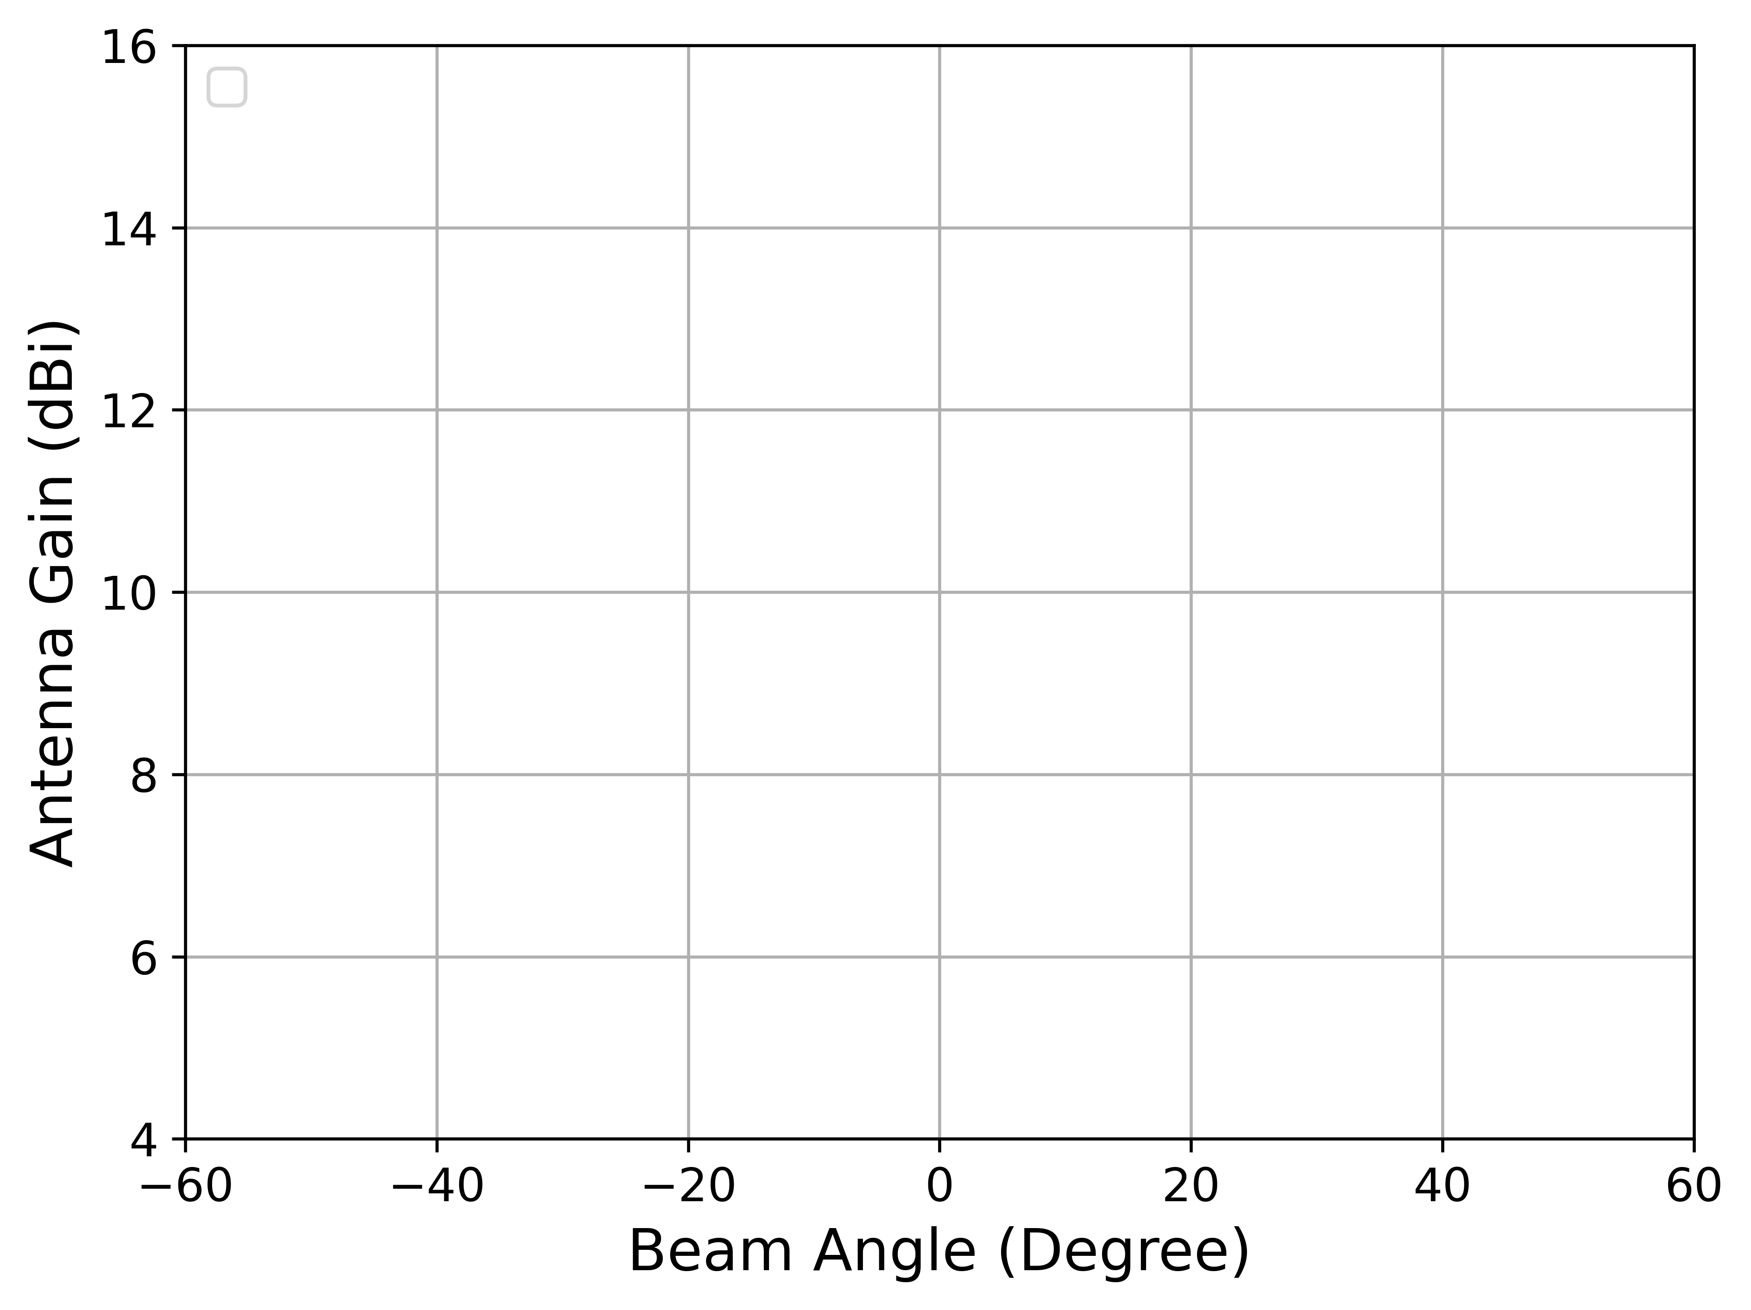
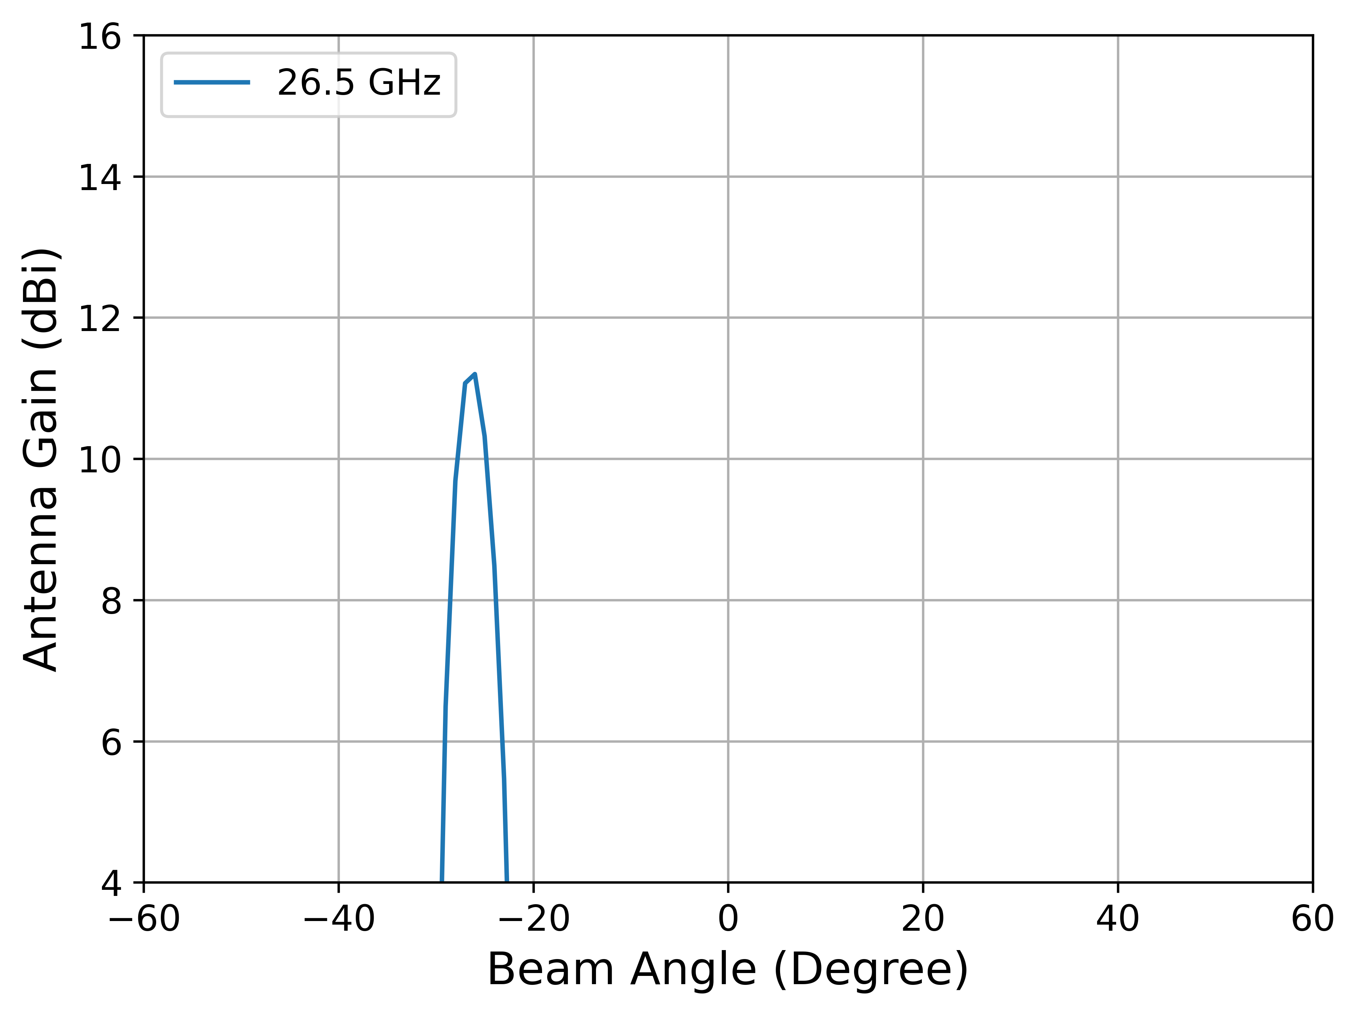
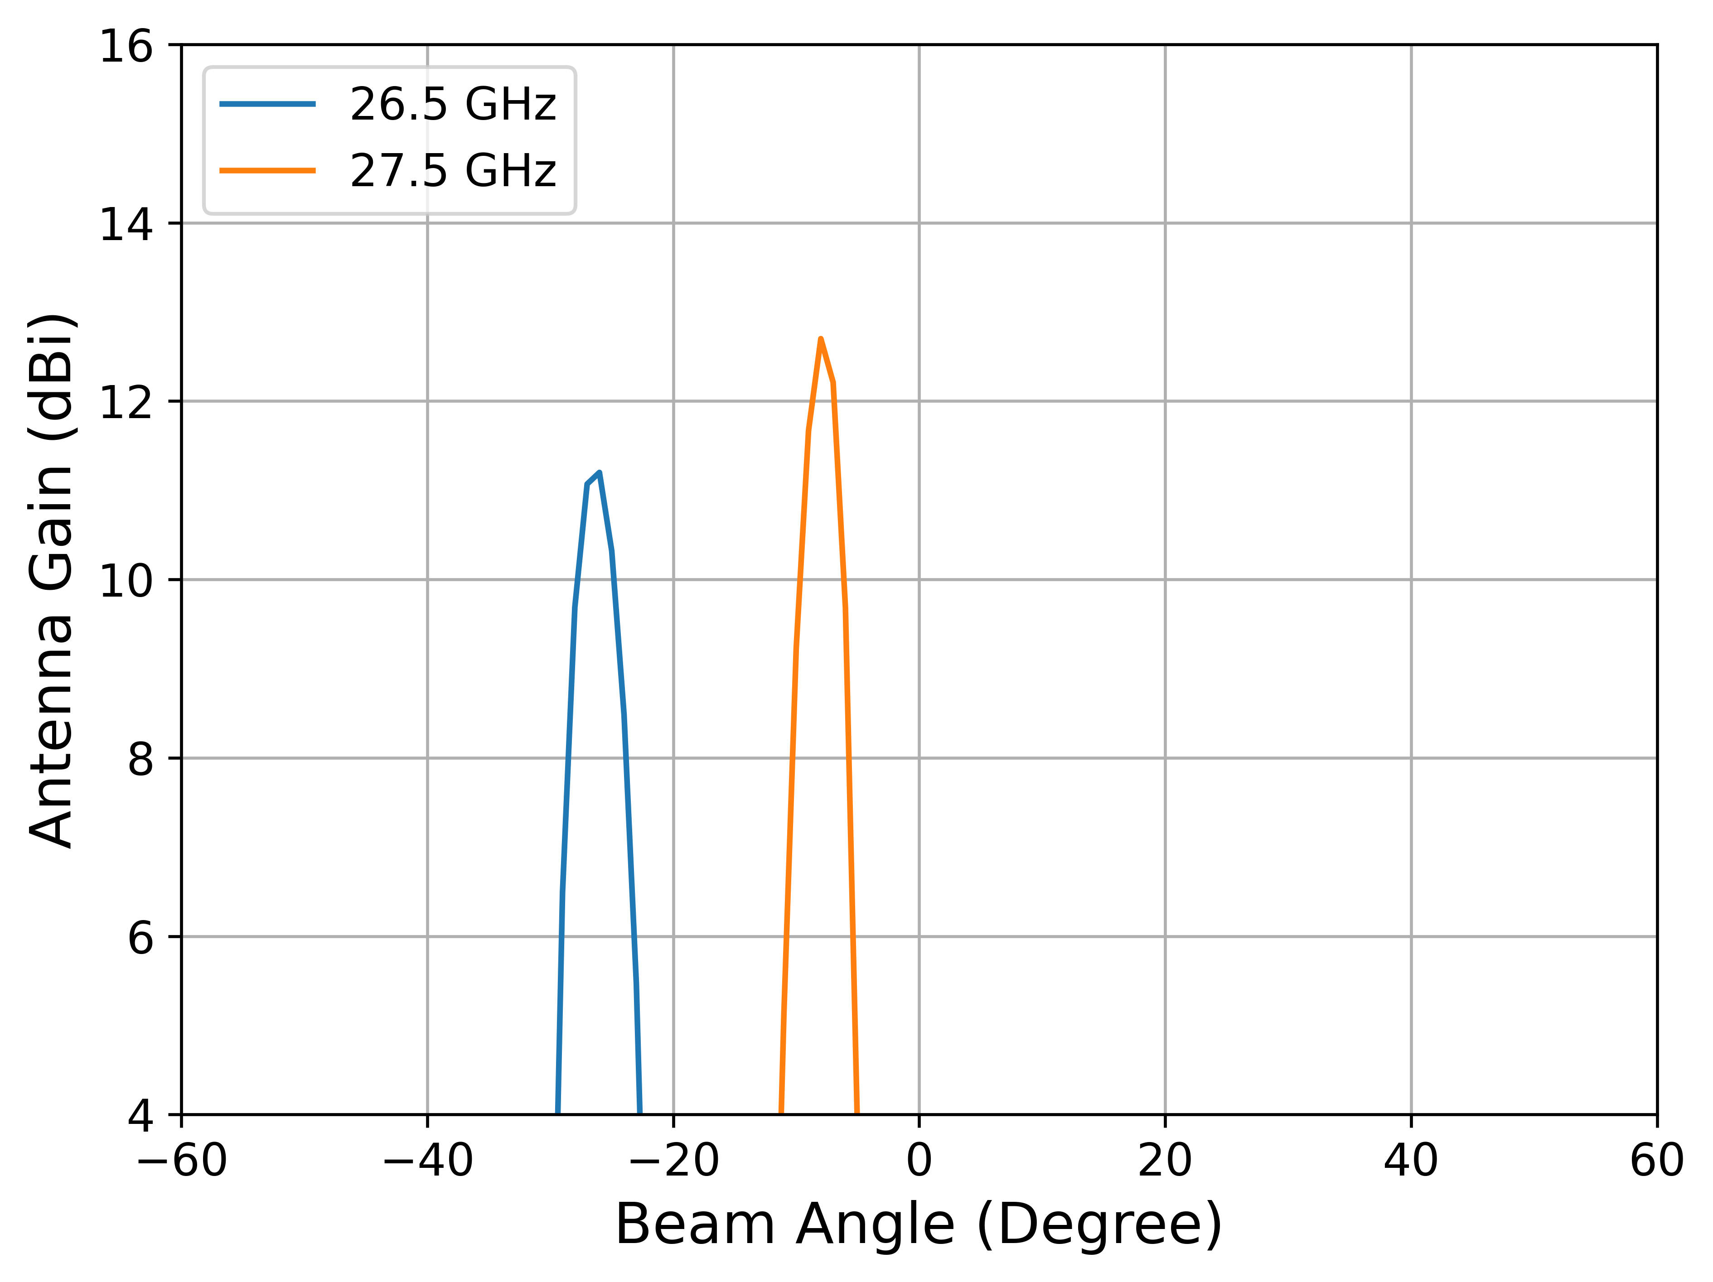
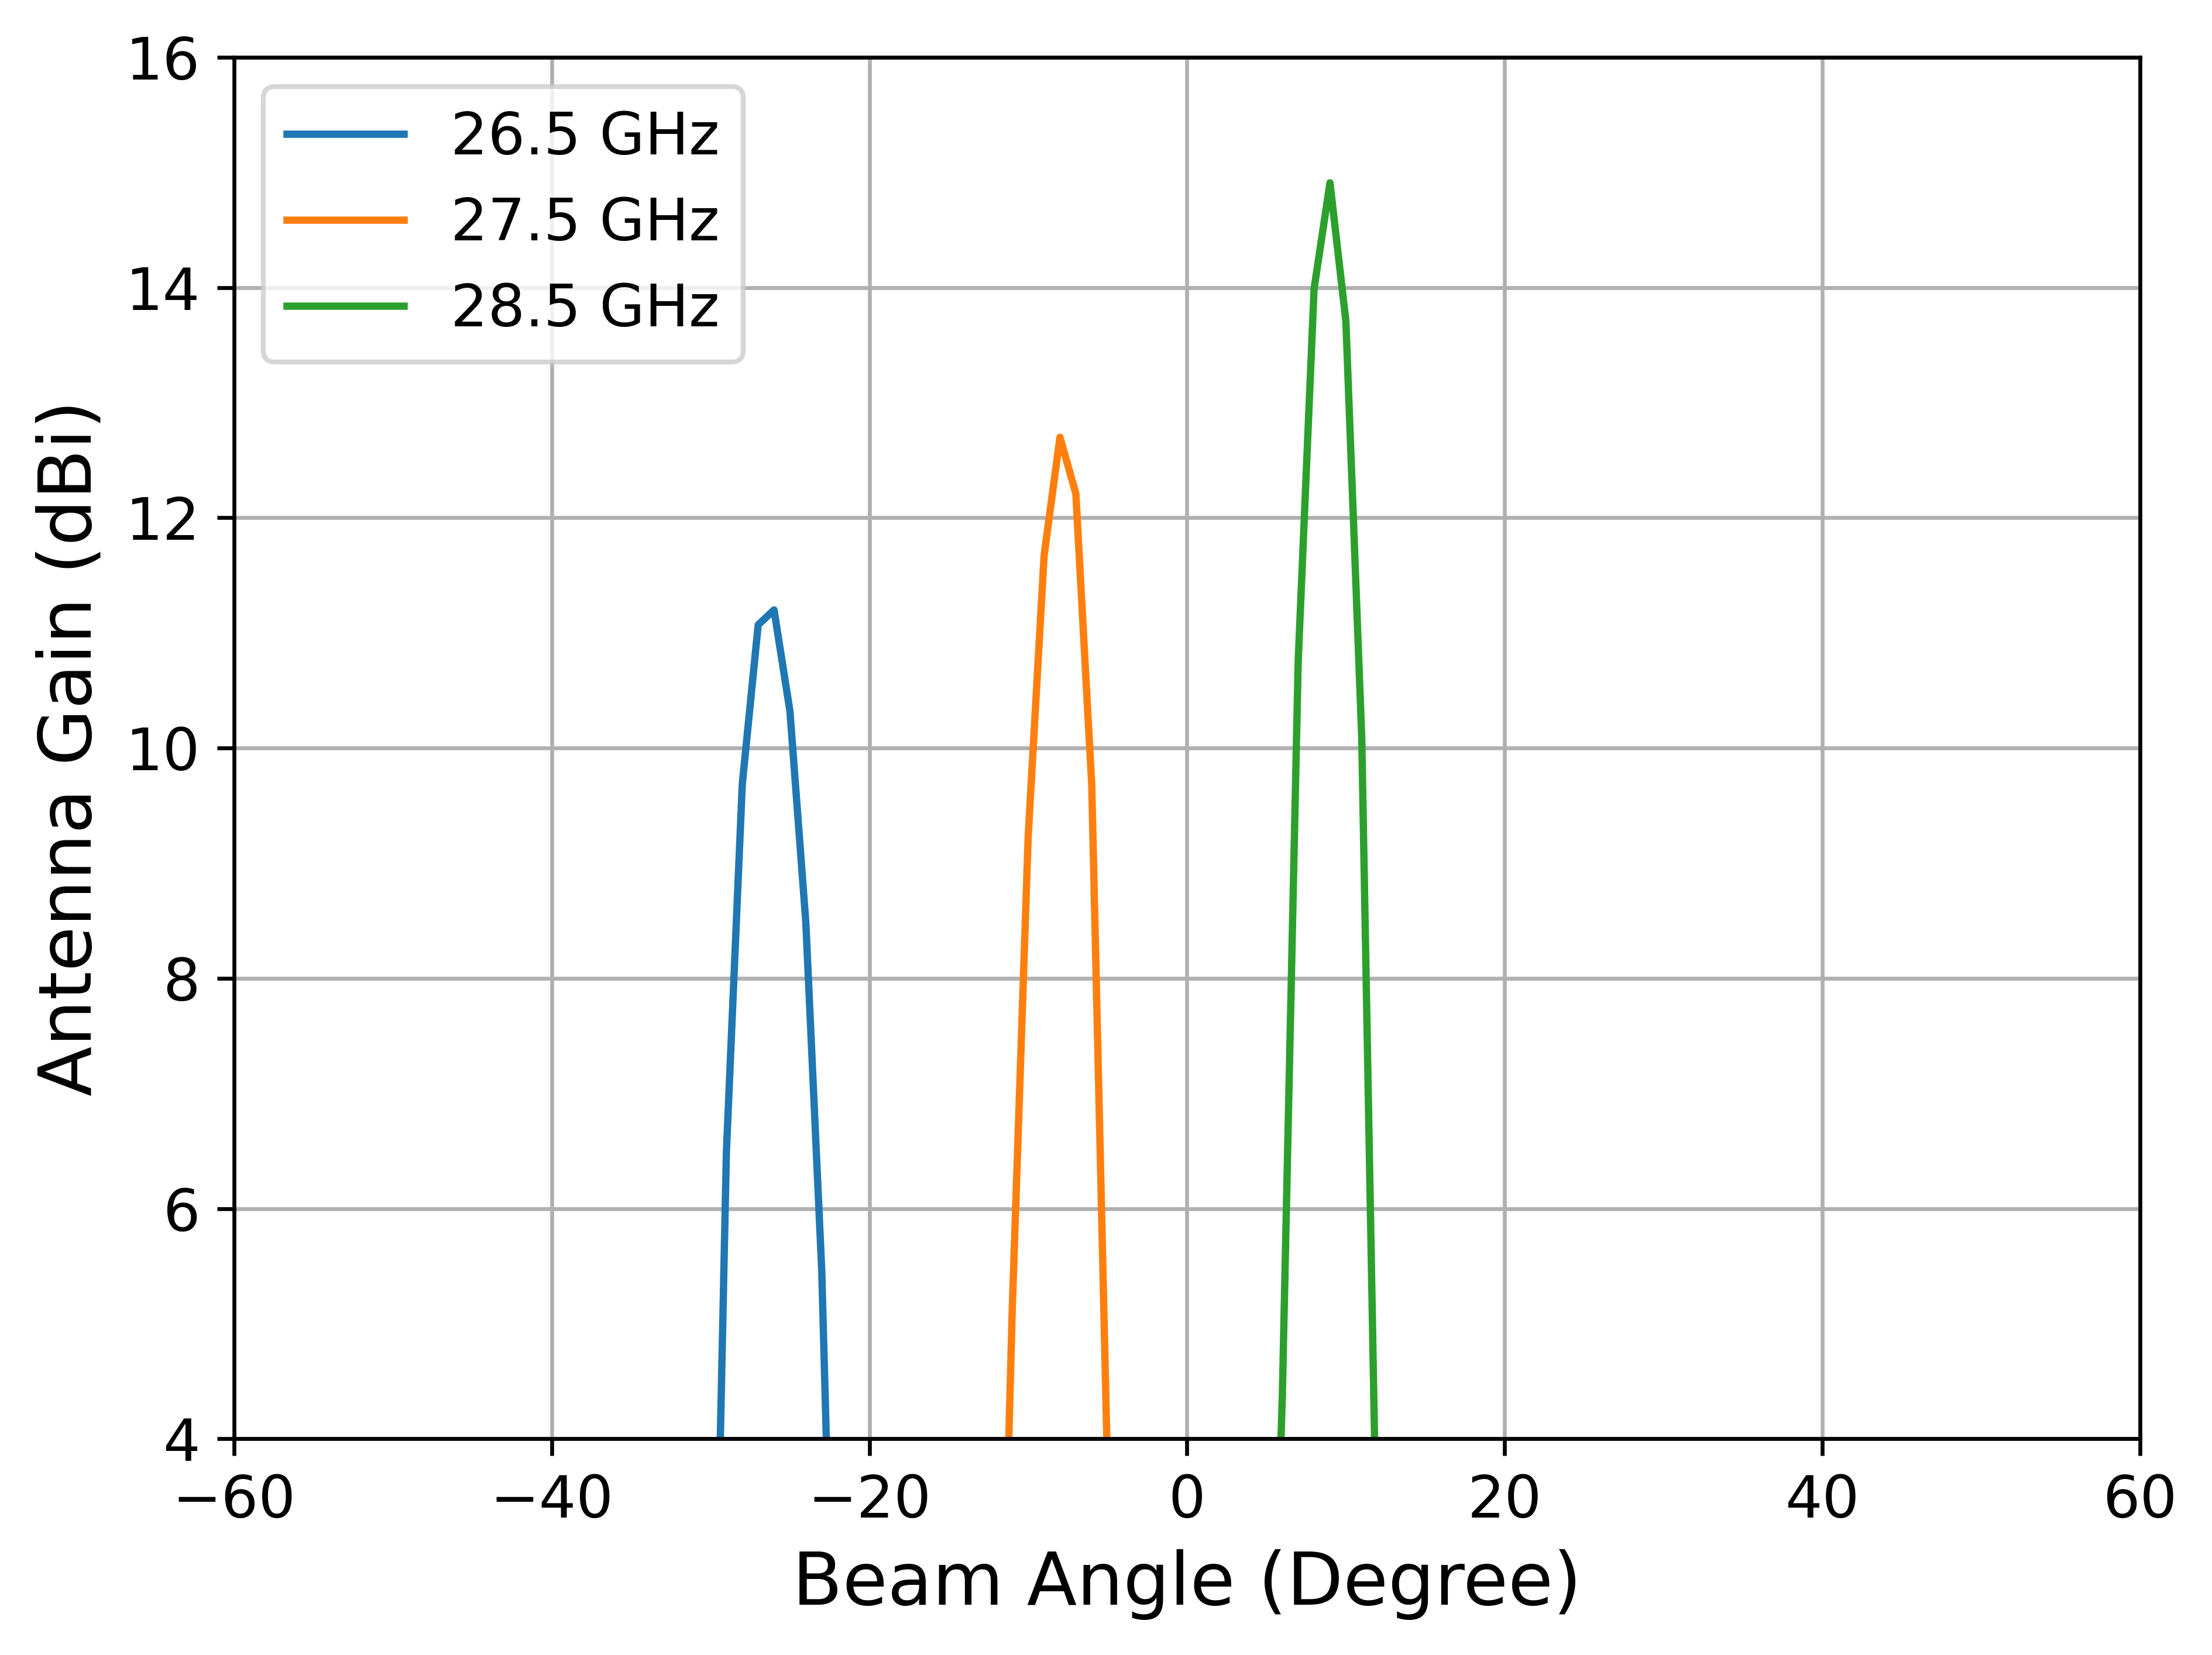
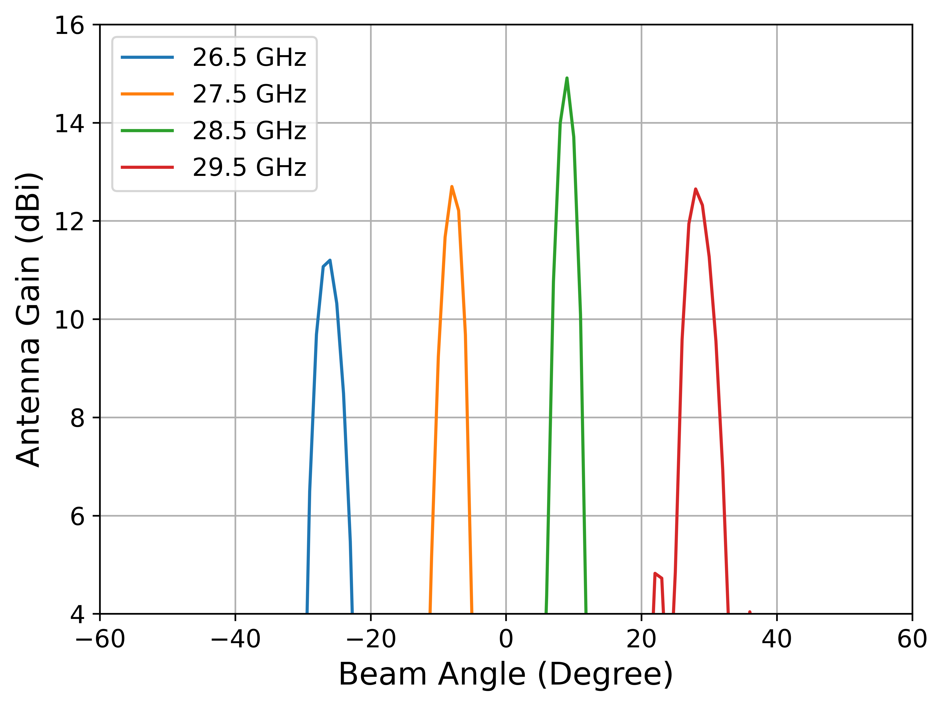
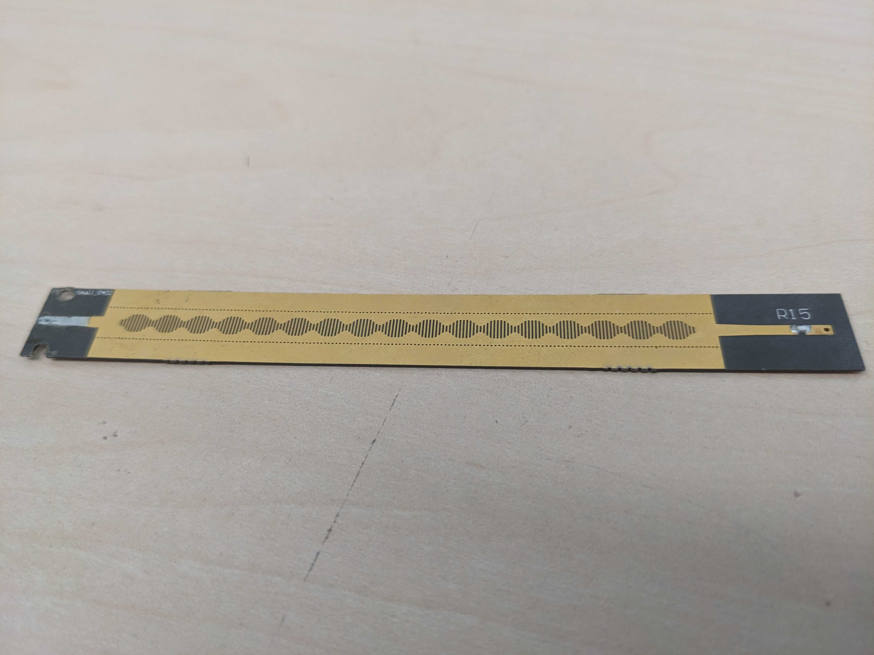

Evaluation
Our FSA Design
$$110×7×0.5 mm$$
Our FSA design has high antenna gain and wide coverage angles
Notes:
Now we present some of our evaluation results. First, we show our FSA design. It’s of size 110 by 7 by 0.5 mm. We plot the antenna gain versus beam angle for our design, as you can see, for the signal of different frequencies, the beam points towards different directions. Over all, our FSA design have more than 10 dBi gain and scan a wide angle in the 3GHz bandwidth.
---
Put a pic of real fsa

Slide 19
Harvest Power vs Distance Measurement
IoT Sensor Power Consumption
Our system can power up IoT sensor from more than 12 meters
Notes:
Finally, we show the harvested power when the harvester is at various distances from the AP. We plot the harvested power versus distance and present the IoT power consumption as a reference. As you can see, it is able to power up an IoT sensor at more than 12 meters away. which aligns with the result of our link budget analysis.
----
Say measurements

Slide 20
Conclusion
Investigated the feasibility of different frequency bands for wireless power transfer and shows mmWave is the best candidate
Proposed a mmWave energy harvesting system and a beam-alignment protocol based on passive beamforming and backscatter technique
Notes:
In summary, in this work, we conducted a comprehensive investigation of the feasiability of using different frequency bands for wireless power transfer, and show that mmWave is the best candidate. Then we proposed a mmWave energy harvesting system with a novel beam-alignment protocol based on passive beamforming and backscatter technique. We believe this paper provides a foundation for future works in building low-power mmWave wireless power transfer systems for indoor IoT Devices.

Slide 21
This Paper
Which spectrum band serves better for wireless power transfer?
How can IoT devices harvest energy from indoor mmWave access points?
Notes:
In this paper, we first answer the question: Which spectrum band serves better for wireless power transfer? Spoiler alert, it’s mmWave. And we propose a novel approach for IoT devices to harvest energy from indoor mmWave access points.

Slide 22
This Paper
How can IoT devices harvest energy from indoor mmWave access points?
How to perform beamforming?
How to do beam alignment?
Notes:
Next, we answer the question: how to harvest energy from indoor mmWave access points.

Slide 23
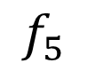
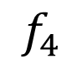
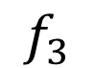
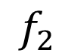
Challenges #2: How to do beam alignment?
Our idea: use mmWave backscatter to provide feedback
f₁ to f₅
$$f_{1},θ_{1}$$
$$f_{3}$$
$$f_{2}$$
$$f_{5}$$
f₁
$$f_{4}$$
Best Frequency & Direction
f₂
f₃
$$f_{1},θ_{2}$$
f₁
f₄
$$f_{1},θ_{3}$$
f₂
f₅
Signal Strength of 1st Harmonic
f₃
$$f_{1},θ_{4}$$
FSA
Rectifier Circuit
AP
f₄
$$f_{1},θ_{5}$$
f₅
$$f_{s}$$
Backscatter Circuit
Beam
direction
$$θ_{1}$$
$$θ_{2}$$
$$θ_{3}$$
$$θ_{4}$$
$$θ_{5}$$
Notes:
To this end, let me show you how we do beam alignment. For a particular signal frequency, AP scan its beam towards a discrete set of directions, and measure the signal strength of the 1st harmonics, as we plot it here. We do this for all the frequencies, which results in a table as show in the left. We pick the combination of frequency and direction that results in the strongest reflected signal as the best alignment with the harvester. You may question that this exhaustive scanning of frequency and direction have a O(n^2) complexity. In fact, we can transmit all frequencies at the same time, and just iterate the beam directions, which will lead to a O(N) complexity.

Slide 24
Challenges #1: How to perform beamforming?
Conventional solution: active beamforming using phased array
Our solution: passive beamforming using Frequency Scanning Antenna (FSA)
f₁
f₂
f₃
FSA
Rectifier
Circuit
IoT Device
f₄
f₅
Advantages:
Zero power consumption
Wide coverage angle
Notes:
The first challenge we need to solve is how to perform beamforming. Since millimeter wave have very high path loss, we need to design the antenna in a way such that energy are focused on a particular direction, which is called beamforming. The conventional approach is to use phased array, which is an active beamforming scheme, which consumes additional energy when adjusting the phase shifters to steer the beam; therefore, is not suitable for IoT devices. Instead, we propose to use a passive beamforming scheme named frequency scanning antenna (fsa). FSA creates beams for different frequencies towards different directions, as shown in this figure. We connect the FSA with rectifier circuit to harvest energy. The advantage is to guarantee a wide coverage angle while consuming zero additional power.

Slide 25
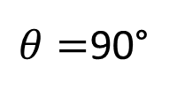
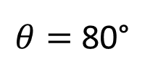
Challenges #2: How to do beam alignment?
Our idea: use mmWave backscatter to provide feedback
$θ=$90°
f₁ to f₅
RSSI
f₁
f₁ f₂ f₃ f₄ f₅
f₂
Freq
θ
f₃
FSA
Rectifier Circuit
$θ=$80°
f₄
AP
RSSI
f₅
$$f_{s}$$
Backscatter Circuit
f₁ f₂ f₃ f₄ f₅
Freq
Notes:
Our idea is to use backscatter technique to provide feedback to the AP. Specifically, instead of directly connecting the FSA to the rectifier circuit, we connect it to a SPDT switch, which switches between ground and rectifier circuit. In the beam alignment mode, the AP transmits a continuous sine wave, and scan its beam direction. In the meanwhile, we flip the switch at a frequency fs to causes a frequency-shift modulation to the backscattered signal. The AP can measure the signal strength of the backscattered, modulated signal to estimate the degree of alignment.
For those who are not familiar with backscatter: in a backscatter system, the node communicates with AP by simply reflect or absorb the signal transmitted by the AP, which leads to variation in signal amplitude
----
Explain backscatter (confirm)
Simultaneously transmit all freq, and steer beams

Slide 26
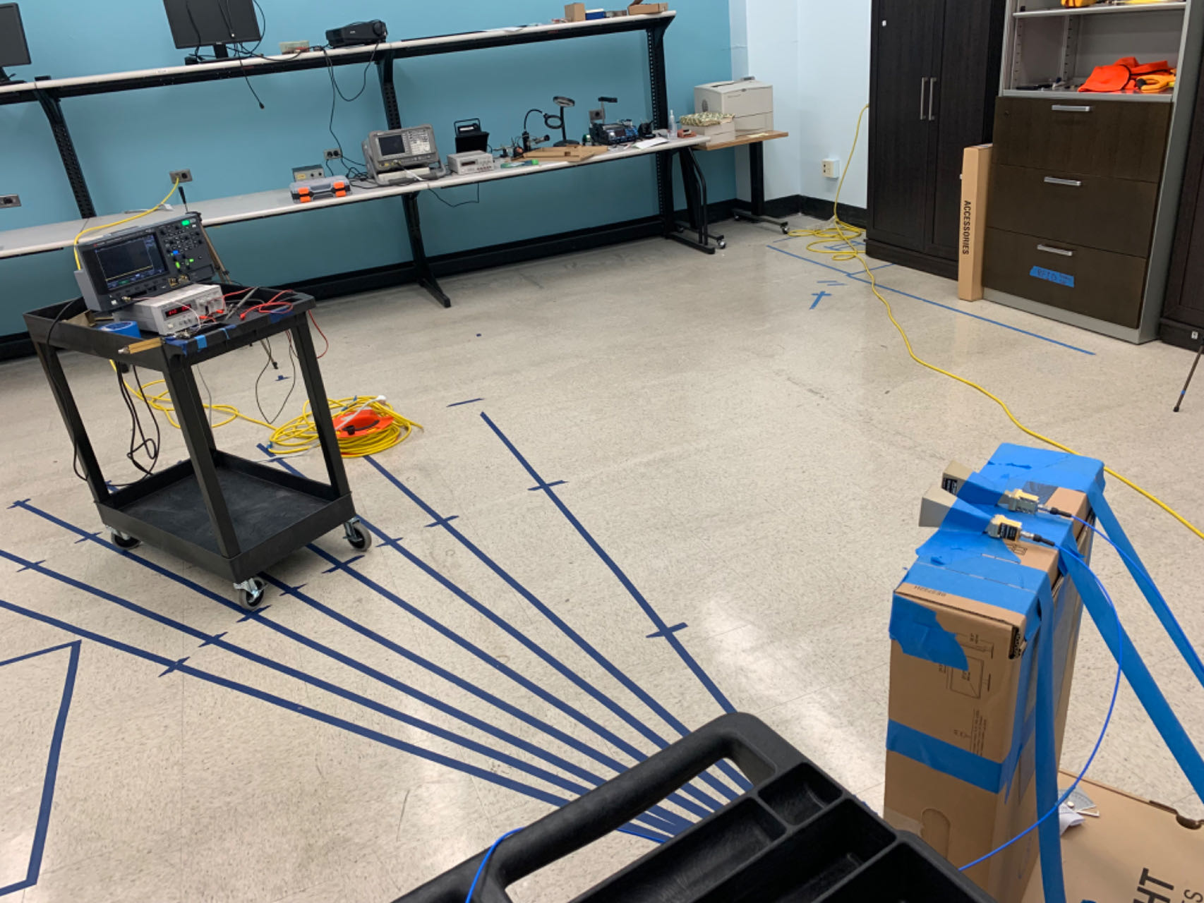
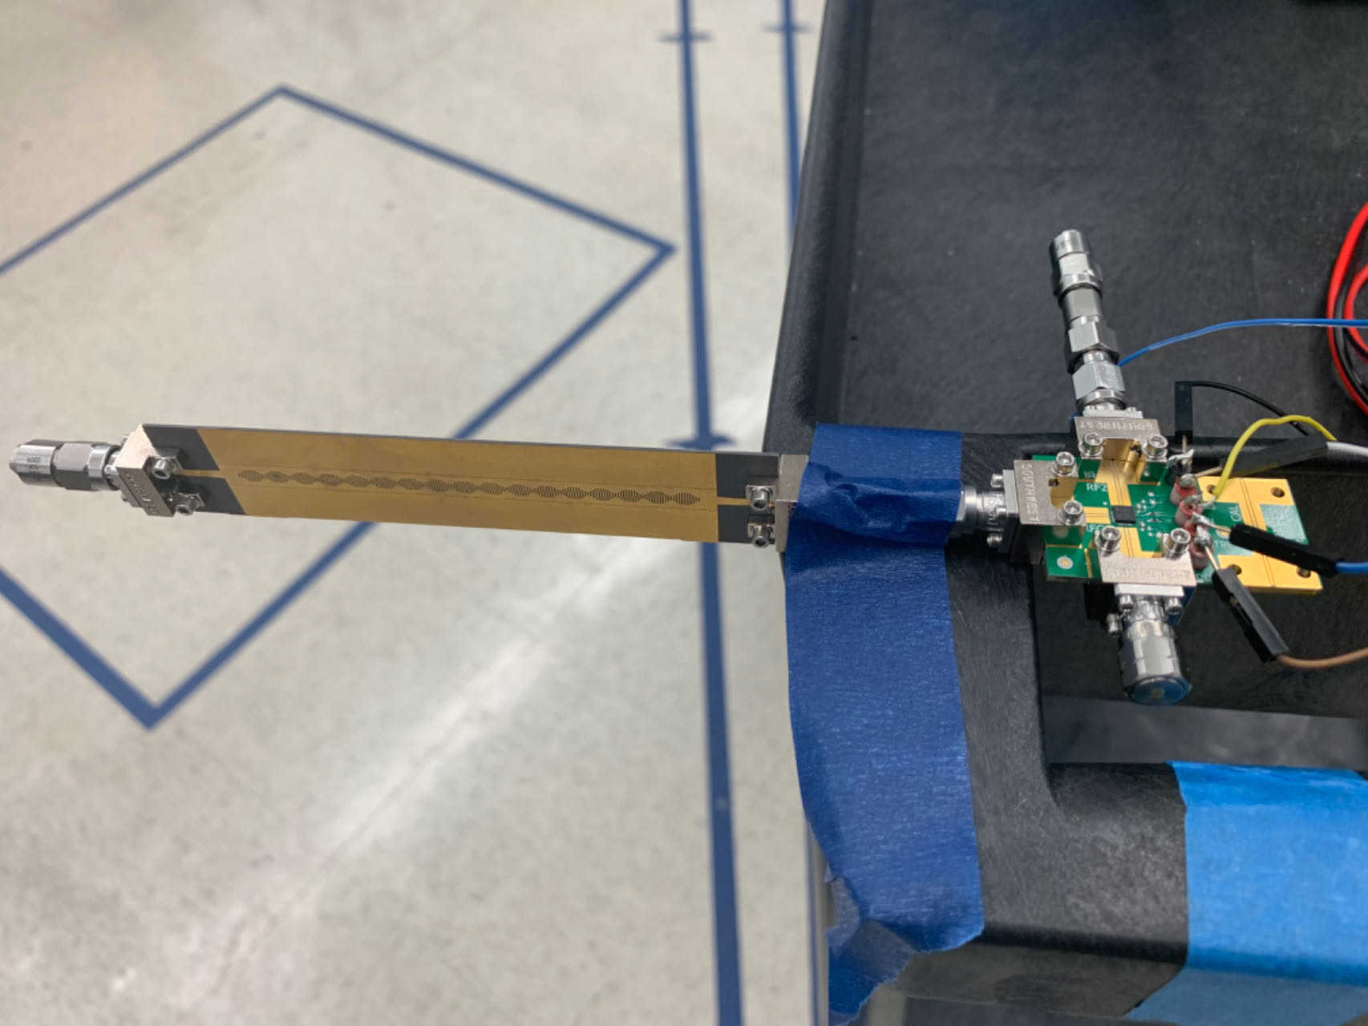

Evaluation
Horn Antennas
f₁
f₂
Signal Generator
Transmitted signal
f₃
FSA
Rectifier Circuit
f₄
Spectrum Analyzer
f₅
Backscattered
modulated signal
$$f_{s}$$
Backscatter Circuit
Backscatter Unit + FSA
Backscatter Circuit
Rx
Tx
FSA
Notes:
This is our evaluation setup. For the AP, we use a signal generator for transmitting the signal and a spectrum analyzer for receiving the backscattered signal. Both are connected to a horn antenna to achieve beamforming. The FSA is connected to a backscatter circuit with signal modulator.

Slide 27
Harvest Power vs Distance Measurement
IoT Sensor Power Consumption
Our system can power up IoT sensor from more than 12 meters
Notes:
This is our measurement result for the harvested power versus distance of our system. As you can see, it is able to power up an IoT sensor at more than 12 meters away. In summary, the third project provides a comprehensive study on the end-to-end performance of different frequencies channels for wirelss power harvesting, as well as proposing a system and protocol for mmWave power transfer.

Slide 28
RSSI Profile Measurement Result
Takeaway message?
Notes:
This is the RSSI profile we captured. As you can see, the AP's beam achieves the best signal strength when it is angled between 35-40 degrees around frequency 28GHz.
The power harvester was indeed placed at around 37 degrees.

Slide 29
mmWave harvester beam alignment
Design goals
Low-Power Beam Alignment
Wide Angle of Coverage
IoT node1
IoT node2
Power Transmitter
IoT node3
Notes:
mmWave power transfer requires beam alignment.
How to achieve low power beam alignment, while guaranteeing a wide angle of coverage?

Slide 30

Existing Works
What’s the issue with the existing work? How do we solve those issues?
Fixed Beam
Grid antenna
Combined DC output
Low conversion efficiency
Requires communication module
WiFi or Bluetooth
Time synchronization
Notes:
We will use the example of a typical mmWave wireless power transfer system, it is a commercialized mmWave power harvesting system called GuRu.
The power transmitter employs beamforming to direct its energy towards the power harvester. Upon receiving the signal, the power harvester measures the signal strength and provide a feedback to the harvest through a communication module. This is usually done using either WiFi or Bluetooth, which increasess both the complexity and power consumption of the harvester.
Additionally, a major challenge with most existing systems lies in their use of fixed beam antennas on the harvester, thereby limiting power harvesting efficiency across various orientations and during mobility
These systems also combine the DC output power of each antenna element on the harvester, leading to suboptimal power conversion efficiency, limiting the system’s working distance

Slide 31
Challenges
Low-power mmWave beamforming
Efficient beam alignment protocol
Self-interference
Notes:
I will quickly go over our design challenges.
First, we need to design a passive beamforming system which can harvest power from multiple directions.
Second, to enable mmWave power transfer, we need an efficient protocol to align the beam of the transmitter with the receiver
Third, we use a backscatter system for beam alignment, which creates self interference between the transmitted and received signal.
For the sake of time I will not go into the details, but they will be discussed in my thesis, next let me show how our evaluation setup.

Slide 32

What is FSA?
Passive system for beam steering
Beam direction depends on signal frequency
FSA Structure
Passive Beam Steering Based on Frequency
Notes:
FSA is a passive structure that transmits a signal toward a specific direction. The direction of the signal depends on the frequency of the input signal.
Rather than relying on active phase shifters, FSA utilizes the physical structure of the antenna to create passive phase shift to generate beams. This is know as passive beamforming. As you can see from the figure, the signal is fed into an input port of the FSA structure, where it radiates into the air through the slots on top of the structure. These slots act like antenna elements to do beamforming.
In summary, FSA provides a way to passively steer the beam in different directions. Due to its low-complexity design, FSA has previously been used in the field of radar and image scanning. In this work, we explore how it can be used for mmWave communication. Now let me explain in detail how FSA works.
In summary, FSA provides a way for passive beam steering, without using phase shifters.
Next, let’s take a look at the working principle of FSA.

